Slide 1
Project High-5
Culture, Collaboration, Commitment, Communication, & Community
Focused ELD for Elementary Level, May 11, 2015
12:45-3:45pm
1. Welcome
2. Review of the Focused ELD Model
3. Models for ELD :Designated and Integrated
4. Lesson Reflections (Think)
5. Language Functions and the ELP Standards
6. Lesson Reflections (Think)
7. Partner Discussions (Pair)
8. Whole Group Discussion on Lessons Learned (Share)
9. Preparing for Staff Meeting Presentation
10. Exit Ticket

Slide 2
Overview of the Model
Planning (January): Further PD on Contextualized ELD lessons and CRP. Teachers and teacher candidates work together on developing lessons using ODE template.
Lesson Delivery (March and April): Teachers deliver their lessons. Peer teacher and teacher candidates from the same school, as well as Maria and Anne, observe the lessons.
Lesson Debriefing, Reflection & Planning for Presentation (Today): One half day : Group shares feedback from observations and teacher reflections on how the lessons went. Prepare presentations for staff meeting.
Presentation at Staff Meeting (next Fall): Teacher groups present at staff meetings and engage in discussions with colleagues.

Slide 3
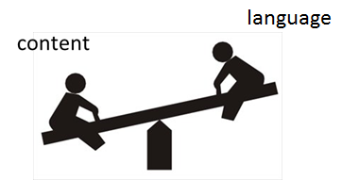
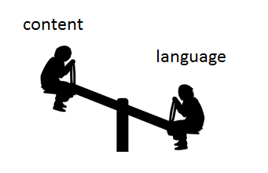
Models for ELD in the Content Classroom
Designated ELD
Integrated ELD
ELD
Content
Teach new language
Recycle/review/practice familiar content
Use ELP standards to guide instruction
Forms and Functions
Differentiated instruction according to proficiency levels of ELL students
Teach new content
Recycle/review/practice familiar language
Use content standards to guide instruction
Literacy, Science, Social Studies, Math
“Sheltered strategies” used to make content accessible

Slide 4
Integrated ELD (within a Sheltered Instruction Model)
Sheltered instruction involves designing lessons that integrate language development and comprehensible content instruction. Sheltered lessons have two goals:
to provide access to mainstream, grade-level content. This is achieved through scaffolding strategies.
to promote language development. This involves carefully analyzing the language demands of the lesson and designing language objectives that will help students increase academic language proficiency.

Slide 5
Integrated ELD: Key Components (Content is “sheltered” for ELLs)
Take into consideration students’ …
background experiences
content knowledge
language proficiency levels
Gradual release of responsibility
Modeling, group practice, independent work
Hands-on activities and cooperative learning
Teacher-centered presentations interspersed w/ small group tasks (e.g., think, pair, share)
Preview/review
Learning centers, drama/role play
Written and oral instructions
Visuals, gestures and linguistic supports
Graphic organizers, pictures, sketches, manipulatives, TPR
Sentence frames, starters, transition words
Primary language support and biliteracy development (e.g., use of cognates)
Guarded vocabulary
Contextual definitions of words and concepts
Repetition
Shorter sentences and simpler syntax
More pauses
Vocab charts, words walls
Monitor, assess, and adjust

Slide 6
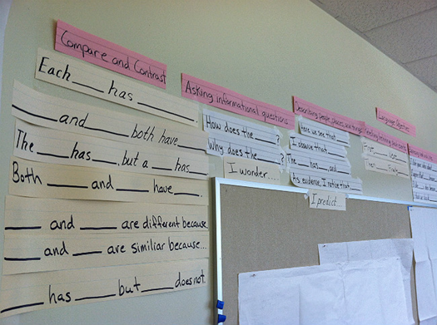
Designated ELD Period (Targeted Language Instruction for ELLs)
Focus on helping English learners develop English language skills.
Taught as a separate subject area on a daily basis.
ELP standards guide instruction. Lesson objectives are differentiated according to students’ language proficiency levels.
Academic vocabulary, forms and functions are taught and practiced.
Tasks incorporate the four language domains (listening, speaking, reading, writing)
Instruction is linked to the content as well as the linguistic needs of the students.

Slide 7
Designated ELD: Key Components (Receptive, Productive and Interactive Language Modalities)
Receptive
(Listening and Reading)
Productive
(Speaking and Writing)
Poems, songs, chants, oral presentations
Listen/read & answer comprehension questions
Listen/read & take notes (lectures, videos), illustrate stories, story mapping)
Essays
Discussion groups, story-telling
Dialogues, role plays, strip stories, photo narratives
Writing workshop
Interactive
(Listening, Speaking, Reading and Writing)
Communicative games, information-gap activities
Interviews, surveys, simulations
Cooperative problem-solving, jigsaws
Developing scripts for Readers’ Theater
Written and oral collaborative research projects

Slide 8
Think… (Pair, Share will follow…)
Look at your notes and reflect on your own lesson:
Was it an “Integrated” or a “Designated” ELD lesson?
Look at the list of “key components” and check the ones you used
What happened before and after the lesson?
If your lesson was “integrated,” did you have a “designated” period before or after it? What did you do?
If your lesson was “designated,” did you have a “integrated” period before or after it? What did you do?

Slide 9
Language Functions
refer
to things and information
create
songs, poems, stories, jokes
narrate
persuade
inform
describe
ask for information
ask for clarification
ask for agreement
express emotions and opinions
interpret
evaluate
summarize
generalize
interact socially
request
offer
paraphrase
introduce
predict
hypothesize
summon
greet
conclude
thank
forgive
apologize
congratulate
direct
advise
warn
threaten
refuse
complain
compliment
metalingual
to discuss and describe language

Slide 10
Which Functions do we need to teach?
refer
to things and information
create
songs, poems, stories, jokes
narrate
persuade
inform
describe
ask for information
ask for clarification
ask for agreement
express emotions and opinions
interpret
evaluate
summarize
generalize
interact socially
request
offer
paraphrase
introduce
predict
hypothesize
summon
greet
conclude
thank
forgive
apologize
congratulate
direct
advise
warn
threaten
refuse
complain
compliment
metalingual
to discuss and describe language

Slide 11
The Fundamental Shift…
Focus on grade level content
How to ensure that a student’s English language development does not interfere with his or her access to grade-appropriate content and practices?
Language
Requires a shift from “What language does the student have?” to “What is the student able to do with language in the content areas?
Influenced by the Understanding Language video of Aída Walqui: Language and the Common Core State Standards
Source: Oregon Department of Education

Slide 12
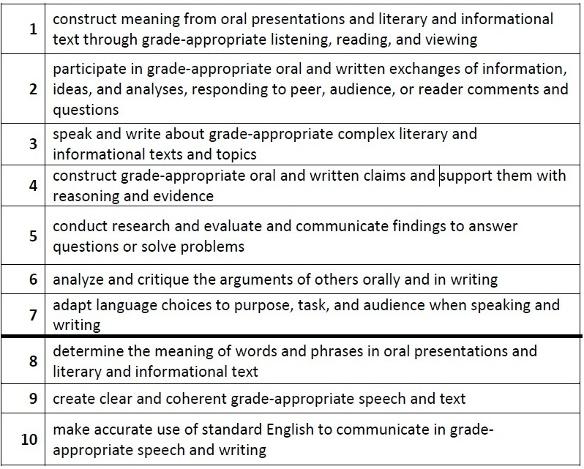
New ELP Standards

Slide 13
What do you notice? What do you wonder?

Slide 14
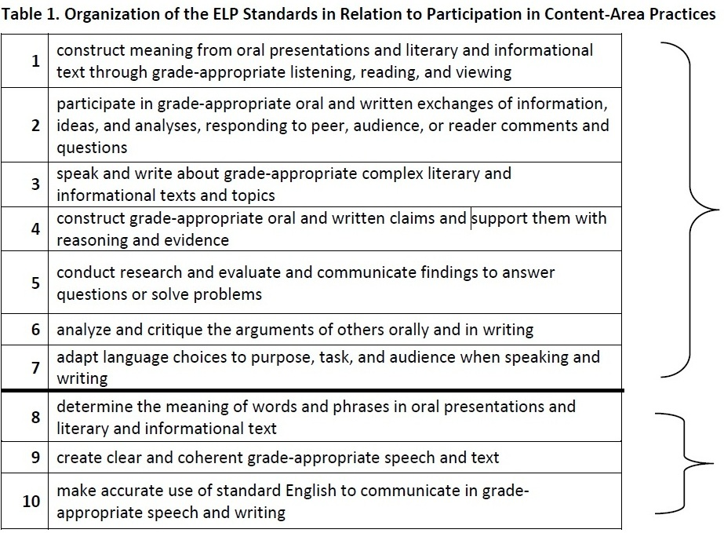
ELP Standards
Notes:
Standards 1 through 7 involve the language necessary for ELLs to engage in the central content-specific practices associated with ELA & Literacy, mathematics, and science. They begin with a focus on extraction of meaning and then progress to engagement in these practices.
Standards 8 through 10 hone in on some of the more micro-level linguistic features that are undoubtedly important to focus on, but only in the service of the other seven standards.
The ELP Standards are interrelated and can be used separately or in combination. (In particular, as shown above, Standards 8–10 support the other seven standards.) The standards do not include curriculum statements, nor do they privilege a single approach to the teaching of social and expressive communication or the teaching of grammar; instead, the standards and descriptors for each proficiency level leave room for teachers, curriculum developers, and states to determine how each ELP Standard and descriptor should be reached and what additional topics should be addressed.

Slide 15
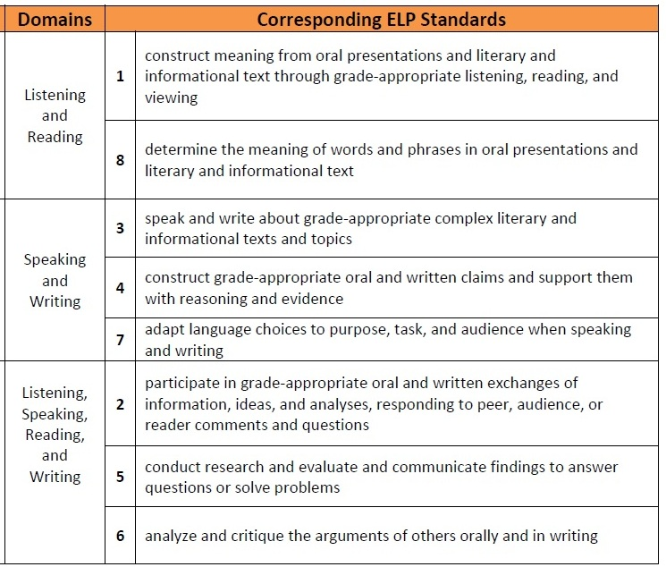
ELP Standards
Modalities
Receptive
Productive
Interactive
Notes:
Receptive modalities: This mode refers to the learner as a reader or listener/viewer working with ‘text’ whose author or deliverer is not present or accessible. It presumes that the interaction is with authentic written or oral documents where language input is meaningful and content laden. The learner brings background knowledge, experience, and appropriate interpretive strategies to the
task to promote understanding of language and content in order to develop a personal reaction.
Productive modalities: The mode places the learner as speaker and writer for a ‘distant’ audience, one with whom interaction is not possible or limited. The communication is set for a specified audience, has purpose, and generally abides by rules of genre or style. It is a planned or formalized speech act or written document, and the learner has an opportunity to draft, get feedback, and revise, before publication or broadcast.
Interactive modalities: Collaborative use of receptive and productive modalities. This mode refers to the learner as a speaker/listener [and] reader/writer. It requires two-way interactive communication where negotiation of meaning may be observed. The exchange will provide evidence of awareness of the socio-cultural aspects of communication as language proficiency develops.

Slide 16
Language Functions
refer
to things and information
create
songs, poems, stories, jokes
narrate
persuade
inform
describe
ask for information
ask for clarification
ask for agreement
express emotions and opinions
interpret
evaluate
summarize
generalize
interact socially
request
offer
paraphrase
introduce
predict
hypothesize
summon
greet
conclude
thank
forgive
apologize
congratulate
direct
advise
warn
threaten
refuse
complain
compliment
metalingual
to discuss and describe language

Slide 17
Unpacking the standards

Slide 18
Think… (Pair, Share will follow…)
Look at your notes and reflect on your own lesson:
What were the language objectives of the lesson?
ELP Standards
Academic vocabulary, forms and functions
Language modalities
What were the content objectives of the lesson?

Slide 19
Pair… (Share will follow…)
Discuss with your partner:
Share your notes and reflections about your lesson
What did you do well in this lesson?
How would you improve it?

Slide 20
Share…
Whole Group Discussion
What went well? (What is going well?)
What have we learned?
What will we do differently?

Slide 21
Preparing for Staff Meeting Presentation

Slide 22
Project High-5
Culture, Collaboration, Commitment, Communication, & Community
Exit Ticket
Before you leave, please answer the following question:
What type of support do you need as you continue to implement the contextualized ELD model next year?

