Slide 1
Project High-5
Culture, Collaboration, Commitment, Communication, & Community
Session 3. Wednesday, August 20, 2014 8:00 – 4:00
1. Four Language Skills and Classroom Assessment
Break
2. Standardized Assessments
Lunch
3. Work Time/Planning for Presentations
4. Presentations
5. Evaluations

Slide 2
Reflection and Discussion:
Assessment of Language Learners

Slide 3
An important principle to remember…
ELD instruction should provide extensive input, and it should also give students opportunities for output and interaction.

Slide 4
Oracy and Literacy
R | ORACY |  | P
E |  |  | R
C |  |  | O
E | Listening | Speaking | D
P |  |  | U
T |  |  | C
I | Reading | Writing | T
V |  |  | I
E |  |  | V
 | LITERACY |  | E

Slide 5
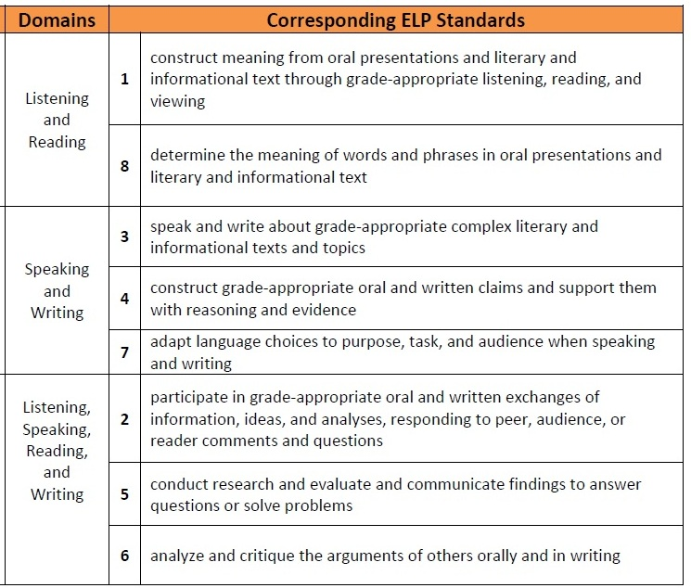
ELP Standards
Modalities
Receptive
Productive
Interactive

Slide 6
Listening
Listening to Repeat | Listening to Understand | Listening for Communication
Poems Songs Chants Dialogues | TPR Listen & answer comprehension questions Listen and take notes Dialogues Lectures TV shows/videos | Communicative games Information-gap activities Interviews Cooperative problem-solving

Slide 7
Speaking
Guided Practice | Communicative Practice | Free Conversation
Dialogues Mini-conversations Role plays Strip stories | Simulations Guessing games Brainstorming Interviews Surveys | Discussion groups Debates Panel discussions Storytelling

Slide 8
Reading
Pre-reading | During-reading | Post-reading
Build background knowledge Relate to students’ lives Pre-teach vocabulary and concepts Examine text organization Modify the text to make it accessible for ELLs (e.g., highlighting, drawing diagrams, adding notes in native language, making an audiotape) | Using Headings and Subheadings Vocabulary Strategies/Clustering Jigsaw Procedure Learning Logs Graphic Organizers Illustrating Stories and Poems/Story Mapping | Journals/learning logs Photo essays Written and oral collaborative research projects Developing Scripts for Readers’ Theater Adapting Stories into Plays and Film Scripts

Slide 9
Writing
 | MOST SUPPORT
Teacher writing | The teacher demonstrates the writing of a text, discussing his/her thinking as he/she writes
Shared writing | The teacher records a text that the children dictate; supports student generation of ideas by asking questions and reflecting on text content, development, organization, conventions, etc.
Choral writing | Teacher and children write a text together; teacher and individual students take turns generating and recording new ideas
Guided writing | Individual children write a text, with the teacher providing support as necessary
Paired writing | Two children write a text together
Independent writing | Each child writes a text independently
 | LEAST SUPPORT

Slide 10
Look at the lessons you have developed so far
Identify activities that encourage students to practice…
Listening
Speaking
Reading
Writing

Slide 11
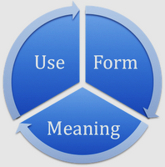
Authentic Formative Assessment
closely monitoring ELL’s language development
by observing their ability to listen, speak, read, and write
in order to be a part of the class and do their school work.
Authentic
assessment tasks are real, communicative uses of language

Slide 12
Some Ways to Assess ELLs in Oral Language, Reading, and Writing
Oral Language (List & Speak)
informal conferencing
observation during cooperative activities
interview—Q & A
picture-cued descriptions
story-telling/relating events
impromptu role plays
debates
various oral presentations
video production
What else?
Reading and Writing
graphic organizers to classify words or phrases
sequencing pictures, sentences, or paragraphs
drawing based on written text
matching words with pictures, words, phrases, sentences; matching sentences with paragraphs
underlining or highlighting main ideas or supporting details
cloze exercises, miscue analysis
discussion groups, comprehension ?s
essays (expository, persuasive)
narratives (real or fictional)
summaries
notes, journals, and logs
portfolio of writing samples
What else?

Slide 13
Look at the lessons you have developed so far…
Identify ways you can assess your ELLs in these areas:
Oral Language (Listening and Speaking)
Reading/Writing

Slide 14
Speaking and Writing Rubric

Slide 15
Effective Practices
Use daily teaching events
Match assessments to instructional practices
Use a variety of tools
Use assessment to plan instruction
Make assessments recursive
Interpret data
Set goals
Collect data

Slide 17
ELPA
English Language Proficiency Assessment
The following links are available on our website (Session 7)
Test specifications
http://www.ode.state.or.us/search/page/?id=496 (not yet operable)
Practice test
http://www.oaks.k12.or.us/students.html (not yet operable)
What CSD will track:
ELPA annually, ADEPT in Jan. & May, Universal Screeners 3x year for LA & Math, grades at each grading period, GPA and SB performance comparison between ELL & non-ELLs

Slide 18
ADEPT
A Developmental English Proficiency Test
Demonstration

Slide 19
Teacher Responsibilities
ELD on Report Cards
OAR—demonstration/monitoring of student progress
Differentiation of instruction that addresses English language development that is of sufficient duration and regularity to have an impact on students’ education and acquisition of English.
District expecations—30 minutes per day on a daily basis (20 min for Kindergarten)
ELD Support Personnel
Laura Zinck K-12
Kira Daczewitz 6-12
Resources
Building ELD folders on Shared Drive “L”

Slide 21
Presentation Schedule
Elementary
Karla and Renae: Kindergarten
Hope and Jessie: 2nd grade
Brittney: 2nd grade
Jason: 3rd grade
Brian: 4th grade
Ann: Literacy
Secondary
Adrienne, Alisha, and Kelsey: 7th and 6th grade
Kari and TJ: 8th grade
Roseanne, Lauri, Li, and Ben: High School
Kira: ELD specialist

Slide 23
Course/Workshop Evaluation

Slide 24
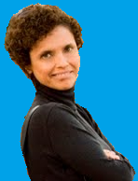
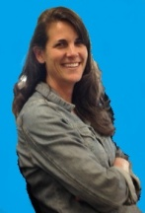
Project High-5
Culture, Collaboration, Commitment, Communication, & Community
Exit Ticket
Before you leave, please answer the following question:
What are specific ways we can support throughout the year you as you continue to work on your contextualized ELD model?

