Slide 1
Project High-5
Culture, Collaboration, Commitment, Communication, & Community
Contextualized ELD for Elementary and Secondary Level, August 17, 2015, 8:30am -4:00pm
1. Introductions
2. Overview of High Five Grant
3. Educational Equity: Reflections
4. Cultural Competence and Culturally-responsive Pedagogy
5. Plans for Personal Growth
Break
6. Review of Components of Contextualized ELD Model
Lunch
7. ELP Standards: Practices - Functions - Forms
8. ELD Lesson Plan Template
9. Work Time: Unit/Lesson Planning
10. Exit Tickets & Looking Forward

Slide 2
Welcome to Project High Five
Culture
Collaboration
Commitment
Communication
Community
ODE Culturally Responsive Pedagogy and Practices Grant
Notes:
Please sign in.

Slide 3
Pair-Share: Educational Equity
What is your own definition?

Slide 4
Equality vs. Equity
Think of a particular student or situation that illustrates your definition of equity.
Write a short vignette narrating the experience it to share with your colleagues.

Slide 5
Cultural Competence
Cultural Competence is NOT
COLORBLINDNESS (such as saying, “I don’t see race”). Such an attitude can be characterized as a form of racism “because it ignores racialized experiences” (Cammarota, 2014).

Slide 6
Cultural Competence
Cultural Competence IS
“The will and the ability to form authentic and effective relationships across differences”
Howard, 2014, p. 68

Slide 7
Culturally Relevant Pedagogy Ladson-Billings, 1995
Students must
Achieve academic success
Develop and/or maintain cultural competence
Develop a critical consciousness

Slide 8
Academic Success
ALL students must be held to the same high standards
AFFIRMATION must be accompanied by EXPECTATION of achievement

Slide 9
Cultural Competence
Too often, our CLD students’ home lives are not “culturally congruent” with the culture they encounter in school
When teachers find ways to bridge students’ home cultures with their classroom experiences, students are able to maintain their cultural identity and achieve academically.

Slide 10
Critical Consciousness
Students can and should be actively involved in making their communities more equitable.
Students can identify issues they care about and work together toward seeking solutions.

Slide 11
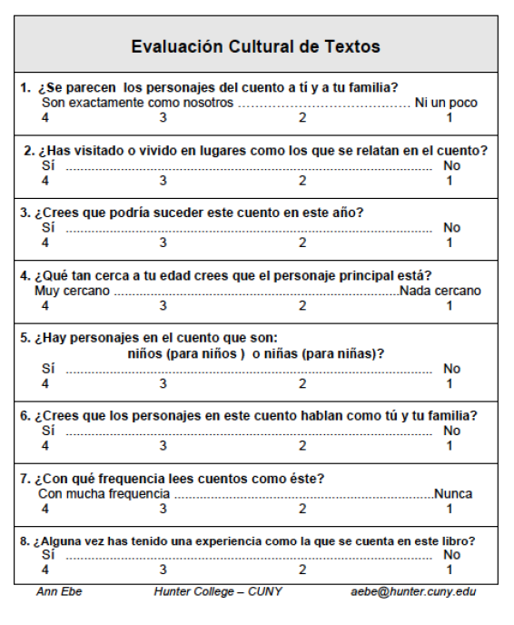
Engaging Students in Evaluation of the Curriculum: Cultural Relevance Rubric
(from Celic & Seltzer, 2011, p. 17)

Slide 12
Reflection

Slide 13
Additive vs. Subtractive Acculturation
Subtractive (assimilation)
Replacement of the old culture with the new
Reflects deficit perspective
Examples of school practices:
Additive
Acquisition of a new culture without rejection of the old
Reflects asset perspective
Examples of school practices:

Slide 14
Engaging with ELL Students and their Families
What countries my families come from
How many of my ELLs were born in the U.S.
What languages they speak
The educational background of families and the school system of their countries
If any of my ELLs are migrants, refugees, or students with interrupted formal education
 If families have experienced war or another traumatic event such as a natural disaster.
What do I know about my ELL students and families?
What do I want to learn?
Who on the staff works most closely with my ELL families?
What would be valuable for my school-wide staff to know?
Talk to former teachers and ELL educators in the district
Find out resources from community
Attend community events where families of ELLs are likely to participate
Enlist a knowledgeable community member or parent
Ask the families

Slide 15
Personal Growth Plans
I have…
I want…

Slide 16
Break

Slide 17
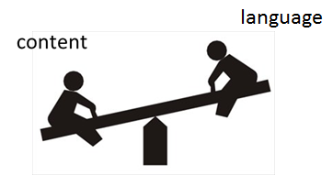
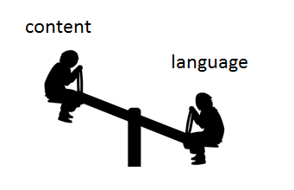
Models for ELD in the Content Classroom
Designated ELD
Integrated ELD
ELD
Content
Teach new language
Recycle/review/practice familiar content
Use ELP standards to guide instruction
Forms and Functions
Differentiated instruction according to proficiency levels of ELL students
Teach new content
Recycle/review/practice familiar language
Use content standards to guide instruction
Literacy, Science, Social Studies, Math
“Sheltered strategies” used to make content accessible

Slide 18
Integrated ELD (within a Sheltered Instruction Model)
Sheltered instruction involves designing lessons that integrate language development and comprehensible content instruction. Sheltered lessons have two goals:
to provide access to mainstream, grade-level content. This is achieved through scaffolding strategies.
to promote language development. This involves carefully analyzing the language demands of the lesson and designing language objectives that will help students increase academic language proficiency.

Slide 19
Integrated ELD: Key Components (Content is “sheltered” for ELLs)
Take into consideration students’ …
background experiences
content knowledge
language proficiency levels
Gradual release of responsibility
Modeling, group practice, independent work
Hands-on activities and cooperative learning
Teacher-centered presentations interspersed w/ small group tasks (e.g., think, pair, share)
Preview/review
Learning centers, drama/role play
Written and oral instructions
Visuals, gestures and linguistic supports
Graphic organizers, pictures, sketches, manipulatives, TPR
Sentence frames, starters, transition words
Primary language support and biliteracy development (e.g., use of cognates)
Guarded vocabulary
Contextual definitions of words and concepts
Repetition
Shorter sentences and simpler syntax
More pauses
Vocab charts, words walls
Monitor, assess, and adjust

Slide 20
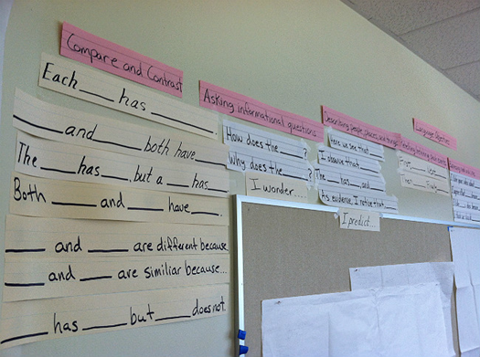
Designated ELD Period (Targeted Language Instruction for ELLs)
Focus on helping English learners develop English language skills.
Taught as a separate subject area on a daily basis.
ELP standards guide instruction. Lesson objectives are differentiated according to students’ language proficiency levels.
Academic vocabulary, forms and functions are taught and practiced.
Tasks incorporate the four language domains (listening, speaking, reading, writing)
Instruction is linked to the content as well as the linguistic needs of the students.

Slide 21
Designated ELD: Key Components (Receptive, Productive and Interactive Language Modalities)
Productive
(Speaking and Writing)
Receptive
(Listening and Reading)
Poems, songs, chants, oral presentations
Listen/read & answer comprehension questions
Listen/read & take notes (lectures, videos), illustrate stories, story mapping)
Essays
Discussion groups, story-telling
Dialogues, role plays, strip stories, photo narratives
Writing workshop
Interactive
(Listening, Speaking, Reading and Writing)
Communicative games, information-gap activities
Interviews, surveys, simulations
Cooperative problem-solving, jigsaws
Developing scripts for Readers’ Theater
Written and oral collaborative research projects

Slide 22
ELD Model for the Elementary Level
During the ELD block…
ELL students stay in their homeroom
Homeroom teacher designs ELD lessons for ELLs in his/her classroom (30-minute periods daily)
ELD lessons are developed using the ELP standards & utilizing content from other areas of the curriculum (e.g., literacy, science, social studies)
Non-ELL students are grouped in appropriate ways and work on relevant tasks during this period

Slide 23
Possible class formats…
Integrated ELD
Designated ELD
Literacy block
ELD block
ELLs receive ELD contextualized instruction
All other students continue literacy rotations independently

Slide 24
Possible class formats…
Integrated ELD
Designated ELD
Whole-group instruction
(e.g., GLAD unit)
ELD block
All students participate
ELLs receive contextualized ELD instruction
All other students work on relevant group tasks independently

Slide 25
ELD Model for the Secondary Level
Collaborative Contextual ELD…
Language Arts selected as the “collaborator” for designing ELD lessons tied to context of instruction as it is only common Content area for all ELLs during remainder of day
Other content areas can implement sheltered strategies and “integrated ELD” as needed

Slide 26
Designated ELD
Integrated ELD
ELA
ELD
ELLs participate
All students participate
ELP standards guide instruction
CCSS for ELA guide instruction
Content from ELA class is the vehicle for language instruction
ELD functions and forms are reinforced and practiced

Slide 27
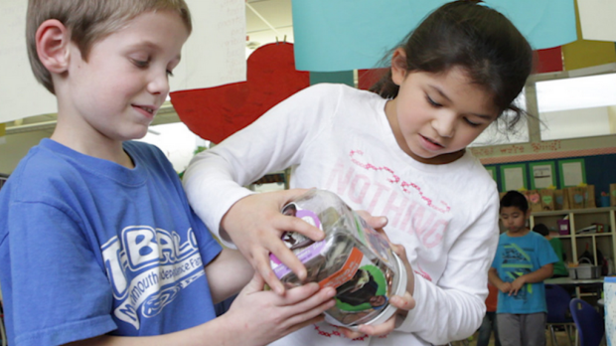
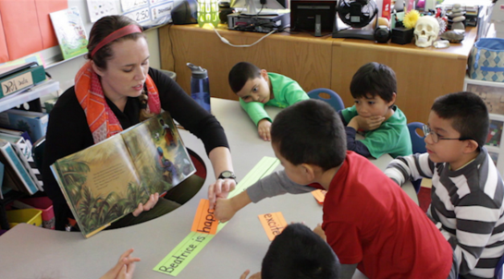
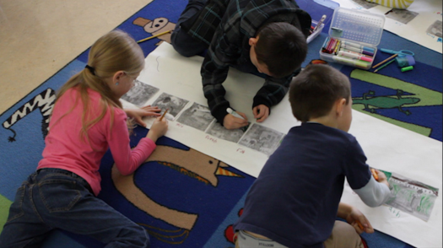
An Elementary Example…
First grade classroom
Social studies unit focusing on a fundraiser for Heifer International
Literacy focus: Beatrice’s Goat
Math focus: keeping track of donations
ELD focus: descriptions (adjectives) and cause/effect
Extension activity: – ordering pictures and retelling the story

Slide 28
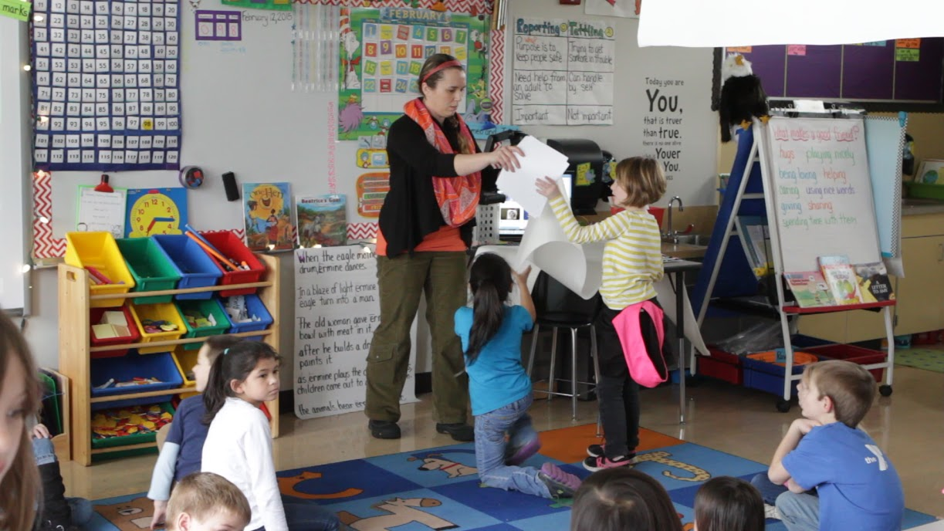
Contextualized ELD: Video Clip
http://youtu.be/AeIZiXxZ4u0

Slide 29
Contextualized ELD
What is working well?
What do I need help with?
What is your understanding of the model?
What needs do you see for the upcoming year?

Slide 30
Lunch Break

Slide 31
Standards
Math
CCSS for math
ELA
CCSS for ELA
Science
NGSS for science
English Language Proficiency Standards
corresponding to ELA, Math, and Science Practices
K-12 ELA Standards and 6-12 Literacy Standards

Slide 32
Language Functions
refer
to things and information
create
songs, poems, stories, jokes
narrate
persuade
inform
describe
ask for information
ask for clarification
ask for agreement
express emotions and opinions
interpret
evaluate
summarize
generalize
interact socially
request
offer
paraphrase
introduce
predict
hypothesize
summon
greet
conclude
thank
forgive
apologize
congratulate
direct
advise
warn
threaten
refuse
complain
compliment
metalingual
to discuss and describe language

Slide 33
Which Functions do we need to teach?
refer
to things and information
create
songs, poems, stories, jokes
narrate
persuade
inform
describe
ask for information
ask for clarification
ask for agreement
express emotions and opinions
interpret
evaluate
summarize
generalize
interact socially
request
offer
paraphrase
introduce
predict
hypothesize
summon
greet
conclude
thank
forgive
apologize
congratulate
direct
advise
warn
threaten
refuse
complain
compliment
metalingual
to discuss and describe language

Slide 34
The Fundamental Shift…
Focus on grade level content
How to ensure that a student’s English language development does not interfere with his or her access to grade-appropriate content and practices?
Language
Requires a shift from “What language does the student have?” to “What is the student able to do with language in the content areas?
Influenced by the Understanding Language video of Aída Walqui: Language and the Common Core State Standards
Source: Oregon Department of Education

Slide 35
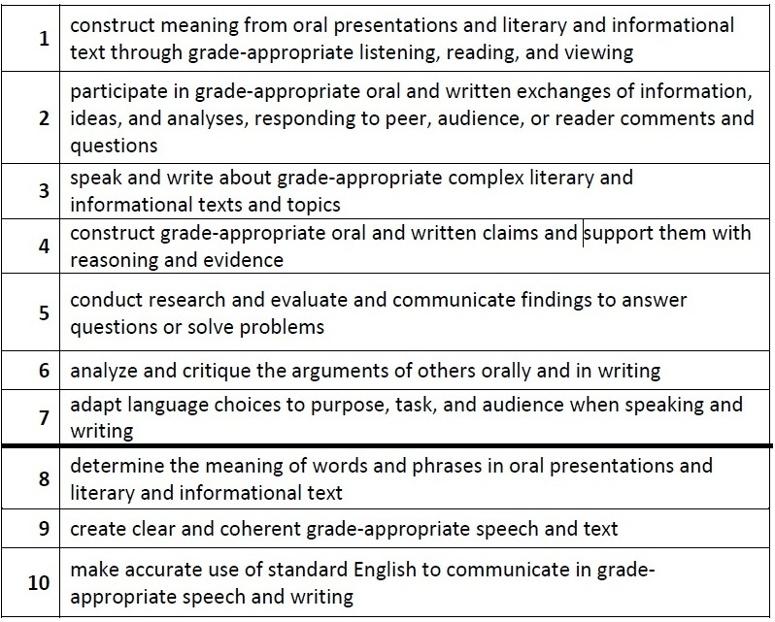
New ELP Standards

Slide 36
What do you notice? What do you wonder?

Slide 37
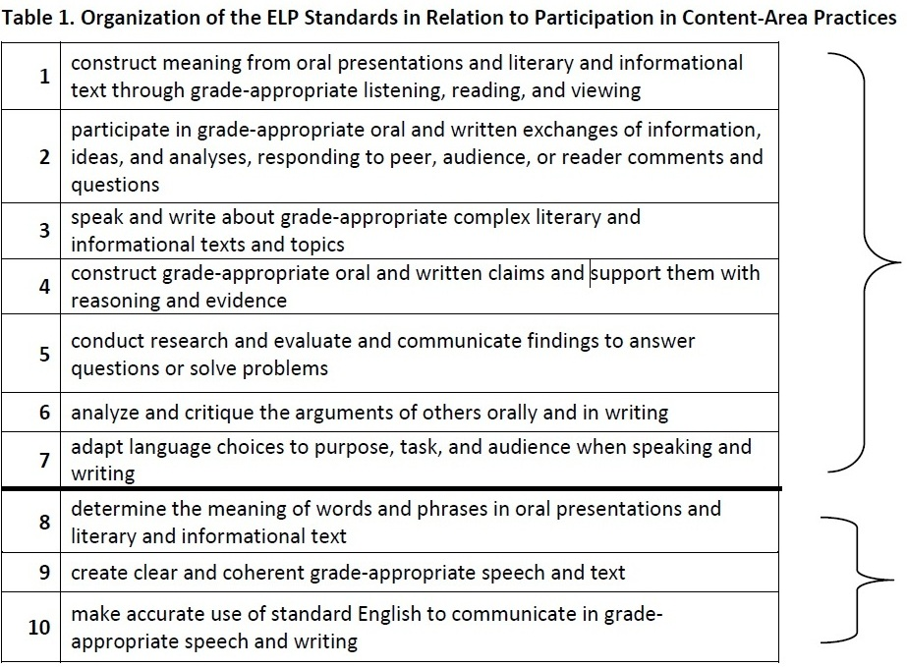
ELP Standards
Notes:
Standards 1 through 7 involve the language necessary for ELLs to engage in the central content-specific practices associated with ELA & Literacy, mathematics, and science. They begin with a focus on extraction of meaning and then progress to engagement in these practices.
Standards 8 through 10 hone in on some of the more micro-level linguistic features that are undoubtedly important to focus on, but only in the service of the other seven standards.
The ELP Standards are interrelated and can be used separately or in combination. (In particular, as shown above, Standards 8–10 support the other seven standards.) The standards do not include curriculum statements, nor do they privilege a single approach to the teaching of social and expressive communication or the teaching of grammar; instead, the standards and descriptors for each proficiency level leave room for teachers, curriculum developers, and states to determine how each ELP Standard and descriptor should be reached and what additional topics should be addressed.

Slide 38
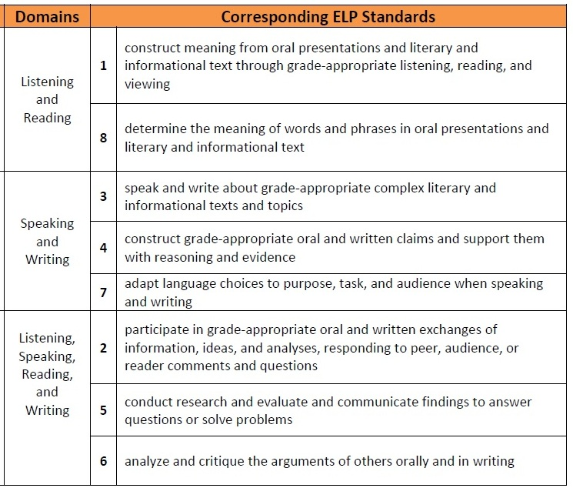
ELP Standards
Modalities
Receptive
Productive
Interactive
Notes:
Receptive modalities: This mode refers to the learner as a reader or listener/viewer working with ‘text’ whose author or deliverer is not present or accessible. It presumes that the interaction is with authentic written or oral documents where language input is meaningful and content laden. The learner brings background knowledge, experience, and appropriate interpretive strategies to the
task to promote understanding of language and content in order to develop a personal reaction.
Productive modalities: The mode places the learner as speaker and writer for a ‘distant’ audience, one with whom interaction is not possible or limited. The communication is set for a specified audience, has purpose, and generally abides by rules of genre or style. It is a planned or formalized speech act or written document, and the learner has an opportunity to draft, get feedback, and revise, before publication or broadcast.
Interactive modalities: Collaborative use of receptive and productive modalities. This mode refers to the learner as a speaker/listener [and] reader/writer. It requires two-way interactive communication where negotiation of meaning may be observed. The exchange will provide evidence of awareness of the socio-cultural aspects of communication as language proficiency develops.

Slide 39
Language Functions
refer
to things and information
create
songs, poems, stories, jokes
narrate
persuade
inform
describe
ask for information
ask for clarification
ask for agreement
express emotions and opinions
interpret
evaluate
summarize
generalize
interact socially
request
offer
paraphrase
introduce
predict
hypothesize
summon
greet
conclude
thank
forgive
apologize
congratulate
direct
advise
warn
threaten
refuse
complain
compliment
metalingual
to discuss and describe language

Slide 40
Language Functions in the ELP Standards
Functions: all are linguistic action verbs.
What can we have students DO during a lesson?
Receptive Interactive Productive
Identify,
Determine
Gather,
Label,
Record,
and Sort information
Participate
Follow rules
Answer
Ask questions
Contribute
Build
Respond
Express
Explain
Introduce & Conclude
Compose written narratives & informational texts
Deliver
Retell/recount
Adapt language choices
Expand and rearrange sentences
Link text using temporal and cohesive words

Slide 41
Unpacking the standards

Slide 42
Work Time: Unit/Lesson Planning

Slide 43
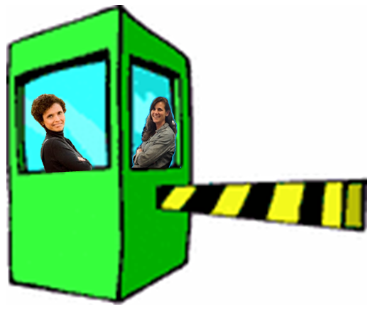
Exit Ticket
Write a personal “Culturally Responsive Creed” (Gay, 2010)
I believe ___________ ; therefore, I will ____________ .
“I believe cultural diversity…should be incorporated into knowledge and skills taught in schools; therefore, I will use ethnic population distribution statistics to teach such mathematical skills as percentages, ratios, and probability.”

