Slide 1
Project LUISA
Language Understanding to Improve Student Achievement
Session 1. Tuesday, Sept 17, 2013, 8:00 – 4:00
1. Introductions and paperwork
2. ELL Language Production (Linguistic Categories)
3. Language Functions and Forms
4. Discussion of Larson-Freeman chapter
Break
5. Models for ELD in the Content Classroom
6. ELP Standards
7. Example Lesson and Discussion of Standards
8. Steps in Lesson Plan Creation and Practice
Lunch
9. ED 607 Syllabus
10. Work Time
11. Looking Forward

Slide 2
ELL Language Production
Elements in the system of language
Phonology: the study of the sounds of a language
Morphology: the study of words and parts of words
Syntax: the study of the structure of sentences and the rules that govern their formation
Semantics: the study of meanings of individual words and of larger units such as phrases and sentences
Pragmatics: the study of language use in context

Slide 4
Language Functions
refer
to things and information
create
songs, poems, stories, jokes
narrate
persuade
inform
describe
ask for information
ask for clarification
ask for agreement
express emotions and opinions
interpret
evaluate
summarize
generalize
interact socially
request
offer
paraphrase
introduce
predict
hypothesize
summon
greet
conclude
thank
forgive
apologize
congratulate
direct
advise
warn
threaten
refuse
complain
compliment
metalingual
to discuss and describe language

Slide 5
Which Functions do we need to teach?
refer
to things and information
create
songs, poems, stories, jokes
narrate
persuade
inform
describe
ask for information
ask for clarification
ask for agreement
express emotions and opinions
interpret
evaluate
summarize
generalize
interact socially
request
offer
paraphrase
introduce
predict
hypothesize
summon
greet
conclude
thank
forgive
apologize
congratulate
direct
advise
warn
threaten
refuse
complain
compliment
metalingual
to discuss and describe language

Slide 6
Language Functions (in school) ODE requirements
Asking
informational questions
clarifying questions
Giving Information
Expressing needs and likes
Expressing and supporting opinions
Retelling/relating past events
Literary analysis
Persuading
Describing people, places, things
Describing spatial and temporal relations
Describing actions
Sequencing
Defining
Explaining
Generalizing
Summarizing
Comparing
Contrasting
Cause and effect
Interpreting
Evaluating
Drawing conclusions
Making predictions
Hypothesizing and speculating

Slide 7
Language Functions and Forms (in school)
Certain Forms are likely to occur with a given Function
Describing people, places, things
On sultry summer days at my grandma’s farm in Michigan, the air gets damp and heavy. Storm clouds drift low over the fields. Birds fly close to the ground. The clouds glow for an instant with a sharp crackling light, and then a roaring, low, tumbling sound of thunder makes the windows shudder in their panes.
from “Thunder Cake,” Literacy by Design, Grade 3
What function stands out in this passage?

Slide 8
Language Functions and Forms (in school)
Certain Forms are likely to occur with a given Function
Describing people, places, things
On sultry summer days at my grandma’s farm in Michigan, the air gets damp and heavy. Storm clouds drift low over the fields. Birds fly close to the ground. The clouds glow for an instant with a sharp crackling light, and then a roaring, low, tumbling sound of thunder makes the windows shudder in their panes.
from “Thunder Cake,” Literacy by Design, Grade 3
concrete nouns

Slide 9
Language Functions and Forms (in school)
Certain Forms are likely to occur with a given Function
Describing people, places, things
On sultry summer days at my grandma’s farm in Michigan, the air gets damp and heavy. Storm clouds drift low over the fields. Birds fly close to the ground. The clouds glow for an instant with a sharp crackling light, and then a roaring, low, tumbling sound of thunder makes the windows shudder in their panes.
from “Thunder Cake,” Literacy by Design, Grade 3
pre-noun modifiers

Slide 10
Language Functions and Forms (in school)
Certain Forms are likely to occur with a given Function
Describing people, places, things
On sultry summer days at my grandma’s farm in Michigan, the air gets damp and heavy. Storm clouds drift low over the fields. Birds fly close to the ground. The clouds glow for an instant with a sharp crackling light, and then a roaring, low, tumbling sound of thunder makes the windows shudder in their panes.
from “Thunder Cake,” Literacy by Design, Grade 3
linking verb + adjective

Slide 11
Language Functions and Forms (in school)
Certain Forms are likely to occur with a given Function
Describing people, places, things
On sultry summer days at my grandma’s farm in Michigan, the air gets damp and heavy. Storm clouds drift low over the fields. Birds fly close to the ground. The clouds glow for an instant with a sharp crackling light, and then a roaring, low, tumbling sound of thunder makes the windows shudder in their panes.
from “Thunder Cake,” Literacy by Design, Grade 3
action verb + prepositional phrase

Slide 12
Language Functions and Forms (in school)
What function stands out in this passage?
Certain Forms are likely to occur with a given Function
Sequencing
Recycling paper involves collecting used paper, sorting it according to color and quality, and cleaning it to remove staples or other non-paper items. Then, the clean, sorted paper is wet down and beaten to loosen the fibers. The recycled fibers can be made into cardboard or newsprint or mixed with wood pulp to make higher-quality paper.
from “How is Paper Made?” Literacy by Design, Grade 3

Slide 13
Language Functions and Forms (in school)
Certain Forms are likely to occur with a given Function
Sequencing
Recycling paper involves collecting used paper, sorting it according to color and quality, and cleaning it to remove staples or other non-paper items. Then, the clean, sorted paper is wet down and beaten to loosen the fibers. The recycled fibers can be made into cardboard or newsprint or mixed with wood pulp to make higher-quality paper.
from “How is Paper Made?” Literacy by Design, Grade 3
adverbs of time/sequence

Slide 14
Language Functions and Forms (in school)
Certain Forms are likely to occur with a given Function
Sequencing
Recycling paper [involves] collecting used paper, sorting it according to color and quality, and cleaning it to remove staples or other non-paper items.
from “How is Paper Made?” Literacy by Design, Grade 3
cohesion: known + new sentence patterns,

Slide 15
Language Functions and Forms (in school)
Certain Forms are likely to occur with a given Function
Sequencing
Recycling paper [involves] collecting used paper, sorting it according to color and quality, and cleaning it to remove staples or other non-paper items. Then, the clean, sorted paper [is wet down and beaten] to loosen the fibers.
from “How is Paper Made?” Literacy by Design, Grade 3
cohesion: known + new sentence patterns,

Slide 16
Language Functions and Forms (in school)
Certain Forms are likely to occur with a given Function
Sequencing
Recycling paper [involves] collecting used paper, sorting it according to color and quality, and cleaning it to remove staples or other non-paper items. Then, the clean, sorted paper [is wet down and beaten] to loosen the fibers.
from “How is Paper Made?” Literacy by Design, Grade 3
cohesion: known + new sentence patterns,
cohesion: known + new sentence patterns, repetition of vocabulary

Slide 17
Language Functions and Forms (in school)
Certain Forms are likely to occur with a given Function
Sequencing
Recycling paper [involves] collecting used paper, sorting it according to color and quality, and cleaning it to remove staples or other non-paper items. Then, the clean, sorted paper [is wet down and beaten] to loosen the fibers. The recycled fibers
from “How is Paper Made?” Literacy by Design, Grade 3
cohesion: known + new sentence patterns,
cohesion: known + new sentence patterns, repetition of vocabulary

Slide 18
Language Functions and Forms (in school)
Certain Forms are likely to occur with a given Function
Sequencing
Recycling paper [involves] collecting used paper, sorting it according to color and quality, and cleaning it to remove staples or other non-paper items. Then, the clean, sorted paper [is wet down and beaten] to loosen the fibers. The recycled fibers
from “How is Paper Made?” Literacy by Design, Grade 3
cohesion: known + new sentence patterns,
cohesion: known + new sentence patterns, repetition of vocabulary

Slide 19
Language Functions and Forms (in school)
Certain Forms are likely to occur with a given Function
Sequencing
Recycling paper [involves] collecting used paper, sorting it according to color and quality, and cleaning it to remove staples or other non-paper items. Then, the clean, sorted paper [is wet down and beaten] to loosen the fibers. The recycled fibers [can be made] into cardboard or newsprint or mixed with wood pulp to make higher-quality paper.
from “How is Paper Made?” Literacy by Design, Grade 3
ing-verbs (used as verbs) turn into
pre-noun modifiers

Slide 20
Language Functions and Forms (in school)
Forms may occur with a given Function
Retelling/relating past events
President Abraham Lincoln was taking a vote in a cabinet meeting on whether to sign the Emancipation Proclamation. All his cabinet secretaries vote nay, whereupon Lincoln raises his right hand and declares: ‘The ayes have it’.

Slide 21
Language Functions and Forms (in school)
Forms may occur with a given Function
Retelling/relating past events
President Abraham Lincoln was taking a vote in a cabinet meeting on whether to sign the Emancipation Proclamation. All his cabinet secretaries vote nay, whereupon Lincoln raises his right hand and declares: ‘The ayes have it’.
past progressive

Slide 22
Language Functions and Forms (in school)
Unexpected Forms may occur with a given Function
Retelling/relating past events
President Abraham Lincoln was taking a vote in a cabinet meeting on whether to sign the Emancipation Proclamation. All his cabinet secretaries vote nay, whereupon Lincoln raises his right hand and declares: ‘The ayes have it’.
simple present
(the ‘historical present’)

Slide 23
Language Functions and Forms (in school)
Unexpected Forms may occur with a given Function
Retelling/relating past events
President Abraham Lincoln was taking a vote in a cabinet meeting on whether to sign the Emancipation Proclamation. All his cabinet secretaries vote nay, whereupon Lincoln raises his right hand and declares: ‘The ayes have it’.
compare:
All his cabinet secretaries voted nay, whereupon Lincoln raised his right hand and declared: ‘The ayes have it’.
simple present
(the ‘historical present’)

Slide 24
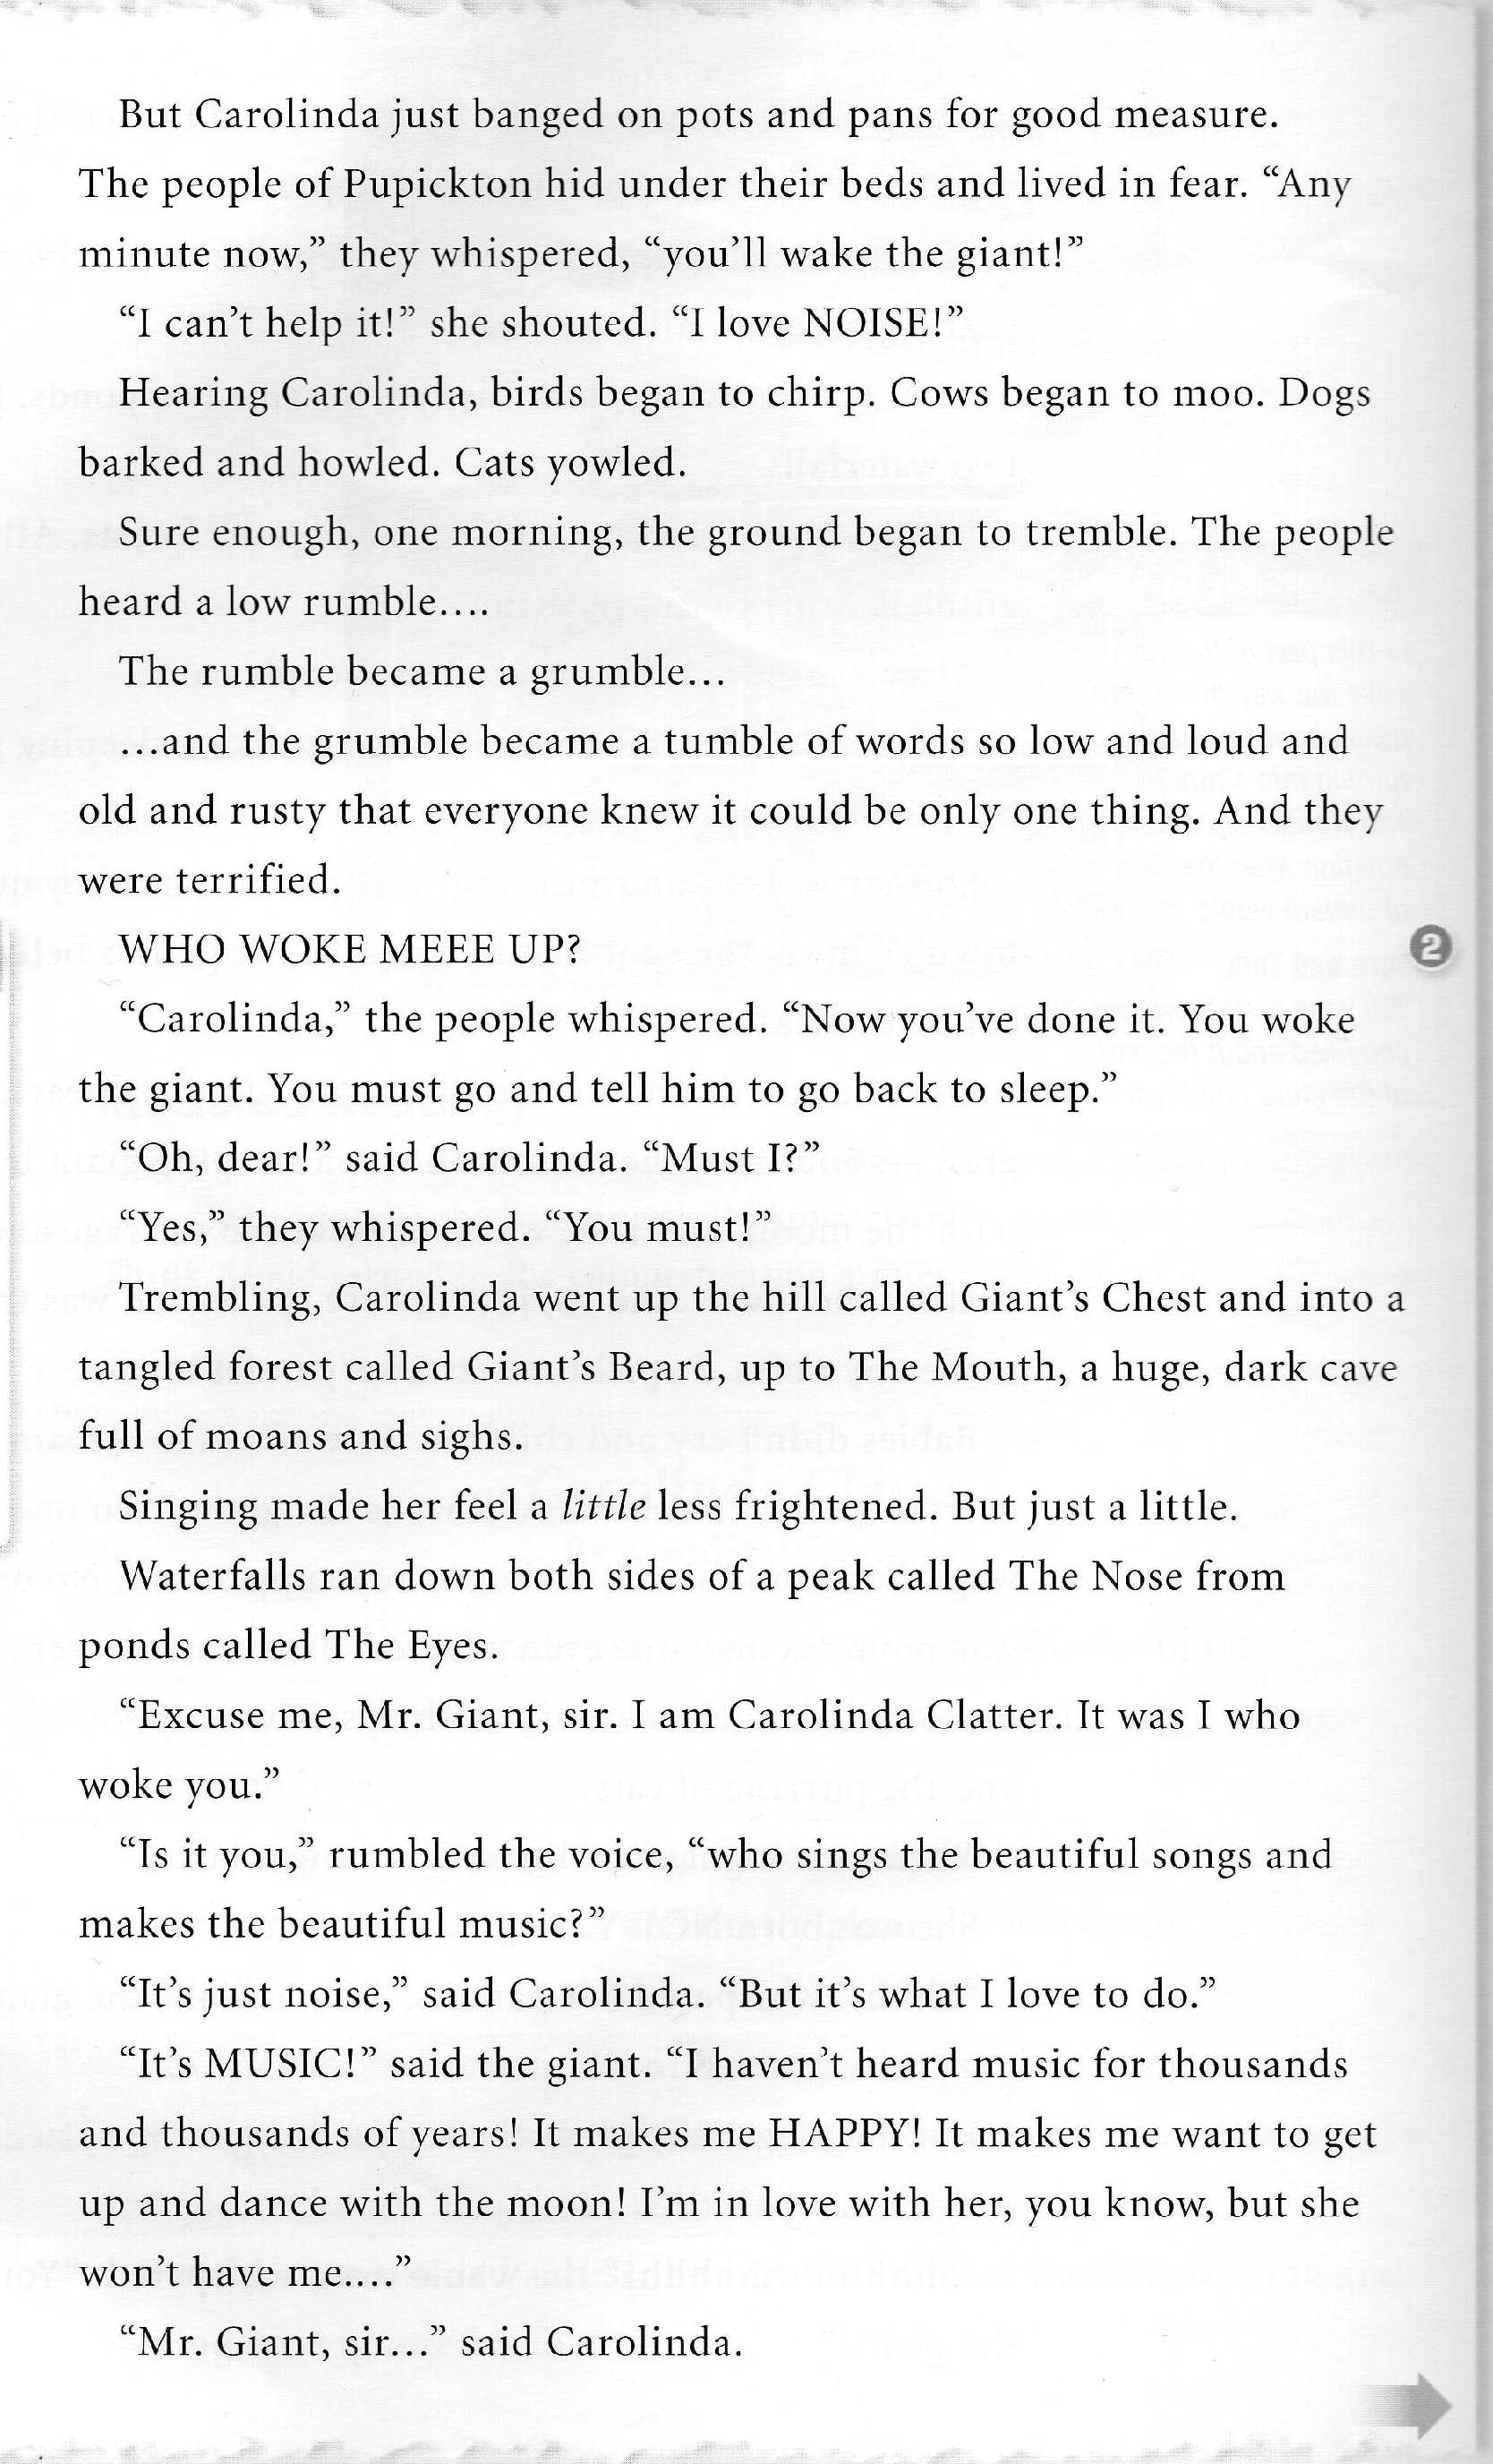
Language Functions and Forms (in school)
It is likely that a text displays several functions in close proximity.
Describing people, places, things
Describing spatial and temporal relations
Retelling/relating past events
Describing actions
Defining
Explaining
Drawing conclusions
Making predictions
And uses a wide variety of typical forms to convey meaning.

Slide 26
Jigsaw Activity with Larsen-Freeman, 2001

Slide 27
Section 1: A Three-Dimensional Grammar Framework and the Learning Process
1. Larsen-Freeman asserts that
“research has shown that teachers who focus students’ attention on linguistic form during communicative interactions are more effective than those who never focus on form or who only do so in decontextualized grammar lessons” (p. 251).
Explain this idea and how it can be applied to classroom practice.
2. Summarize the author’s four insights regarding the learning process.
How can such considerations inform your classroom practice?

Slide 28
Section 2: Form and Meaning
1. Regarding form, Larsen-Freeman writes
“Is it important to emphasize meaningful practice of form for several reasons” (p. 258).
Please explain those reasons and also share some
of the activities she describes for teaching form.
2. In discussing meaning, the author specifically discusses using pictures and realia as well as action games.
Please share these activities, as well as
your own ideas, with the rest of the group.

Slide 29
Section 3: Use and Providing Feedback
1. Model an appropriate classroom activity that
focuses on use, making sure to include some of the strategies Larsen-Freeman discusses for feedback.
2. Larsen-Freeman writes
“While rules provide some security for learners, reasons give them a deeper understanding of the logic of English and help them make it their own” (p. 265).
Explain this idea and how it can inform your own approach in teaching your ELLs.

Slide 30
Final Points on Teaching Grammar (Larsen-Freeman, 2001)
Communicative approaches emphasize language use over rules of language use.
We do not want our students to learn grammatical facts. What we hope to do is to help them use grammatical structures accurately, meaningfully, and appropriately.
“Grammaring” is a skill that needs to be developed.
It is useful for teachers to have a grammar checklist rather than relying on a grammatical sequence.
The three dimensions do not always need to be present in one lesson. The teacher prioritizes them depending on students’ needs.

Slide 31
Three-Dimensional Grammar Framework
MEANING/
SEMANTICS
USE/
PRAGMATICS
FORM/
STRUCTURE

Slide 33
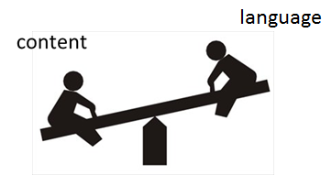
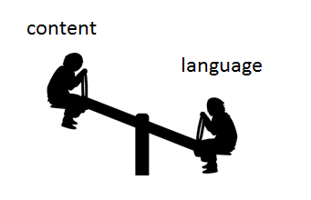
Models for ELD in the Content Classroom
ELD
Content
Teach new language
Recycle/review/practice familiar content
Use ELP standards to guide instruction
Forms and Functions
Differentiated instruction according to proficiency levels of ELL students
Teach new content
Recycle/review/practice familiar language
Use content standards to guide instruction
Literacy, Science, Social Studies, Math
“Sheltered strategies” used to make content accessible

Slide 34
Models for ELD in the Content Classroom
During the ELD block…
ELL students will stay in their homeroom
Homeroom teacher will design ELD lessons for ELLs in his/her classroom
ELD lessons will be developed using the ELP standards & utilizing content from content curriculum
Non-ELL students will be grouped in appropriate ways and work on relevant tasks during this period

Slide 35
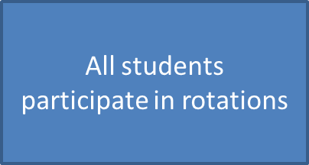
Possible class formats…
Literacy block
ELD block
ELLs receive ELD contextualized instruction
All other students continue literacy rotations independently

Slide 36
Possible class formats…
Whole-group instruction
(e.g., GLAD unit)
ELD block
All students participate
ELLs receive contextualized ELD instruction
All other students work on relevant group tasks independently

Slide 37
ELP Standards

Slide 39
Example of Contextualized ELD
Fourth grade unit: Lewis and Clark
Original lesson:
Teacher models a short Readers’ Theater about Lewis and Clark
Class discussion of hardships of their journey
Students break into groups to write an introduction to their own readers’ theater. Each group has a different text. Some groups have an ELL.

Slide 40
Example of Contextualized ELD
Function:
Describing Actions
Fourth grade unit: Lewis and Clark
Lesson with Contextualized ELD:
Teacher models a short Readers’ Theater about Lewis and Clark
The intro to the reader’s theater contains the sentence:
“Strong and dedicated Lewis and Clark are rafting wildly down the Columbia River.”
The teacher highlights the present progressive verbs throughout the reading by acting out their actions.
Class discussion of the specific actions shown and the hardships of the journey.

Slide 41
Example of Contextualized ELD
Function:
Describing Actions
Fourth grade unit: Lewis and Clark
Lesson with Contextualized ELD:
Teacher breaks students into groups, some with an ELL, and gives each their reader’s theater passage to read.
Teacher pulls out ELLs into a group for ELD time while the other students work on another aspect of the readers’ theater or unit.
Teacher gives ELL group the sentence:
Strong and dedicated Lewis and Clark are rafting wildly down the Columbia River.
(adj) and (adj) Lewis and Clark are (ing-verb) (adverb) (prepositional phrase).
And the chart:
adjectives ing-verbs -ly adverbs prepositional phrases

Slide 42
Example of Contextualized ELD
Function:
Describing Actions
Fourth grade unit: Lewis and Clark
Lesson with Contextualized ELD:
Teacher helps students contribute words and phrases to their chart to describe Lewis and Clark’s journey in their section.
Each ELL uses the sentence frame to write 3 sentences that could be used to introduce their readers’ theater.
ELLs return to their original groups with their introduction sentences. Each group chooses one of the sentences to introduce their readers’ theater.
Groups practice and present their readers’ theater.

Slide 43
Example of Contextualized ELD
Function:
Describing Actions
Fourth grade unit: Lewis and Clark
Lesson with Contextualized ELD:
Challenges:
Keeping students focused and on-task
Students will try to make silly sentences.
(adjective) and (adjective) Lewis and Clark are (ing-verb) (adverb) (prepositional phrase).
Tired and stinky Lewis and Clark are sticking deeply their fingers up their noses.

Slide 44
Example of Contextualized ELD
1. In your ELP standards, find the Describing Actions function.
2. In your Azar book, find and review “present progressive”.
3. Consider the sentence frame from the lesson:
(adjective) and (adjective) Lewis and Clark are (ing-verb) (adverb) (prepositional phrase).
4. Was this an appropriate ELD lesson for the early intermediate and 3 intermediate ELLs in this class?
5. What other positive ELL strategies were used in the lesson?

Slide 45
Steps in Lesson Plan Creation
1. Considering the theme of the unit, the materials, and the needs of your students, choose a function to emphasize.
2. Considering the level of your students—look at the standards, to find examples of forms to teach.
3. Add the function and form to your personal curriculum map.
4. Examine your materials to see if the forms are present in them or if you will need to teach them directly.
5. Fill out Function/Form Analysis Chart
6. What tasks will the students do? (30 min)
(Listening, Reading, Speaking, Writing)
Teacher modeling
Group or scaffolded practice
Individual practice
7. How will I assess students’ learning?

Slide 46
Steps in Lesson Plan Creation
1. Unit theme: Volcanoes. Function: Sequencing
2. Early Intermediate: adverbs of time/sequence
Advanced: subordinating conjunctions
3. Add the functions and forms to my curriculum map.
4. Text p3-12: 1 adv of seq: “at first” (p5)
3 sub conj: “if” (p3), “once” (p6), “when” (p12)
5. See Function/Form Analysis Chart
6. EI: Provide list of adverbs of sequence and sent frames
Ad: Provide list of sub conj and sent frames
Students put pictures in order then tell their story to partner (who has different pictures)
Student writes 1 paragraph story about a volcano erupting based on the photos and book
7. Observation of interaction, 1 paragraph story

Slide 47
Steps in Lesson Plan Creation
1. Considering the theme of the unit, the materials, and the needs of your students, choose a function to emphasize.
2. Considering the level of your students—look at the standards, to find examples of forms to teach.
3. Add the function and form to your personal curriculum map.
4. Examine your materials to see if the forms are present in them or if you will need to teach them directly.
5. Fill out Function/Form Analysis Chart
6. What tasks will the students do? (30 min)
(Listening, Reading, Speaking, Writing)
Teacher modeling
Group or scaffolded practice
Individual practice
7. How will I assess students’ learning?

Slide 49
Afternoon
ED 607 Syllabus
Goals for Work Time

Slide 50
Project LUISA
Language Understanding to Improve Student Achievement
Looking Forward
Next Tuesday
1. Bring any teaching materials for next fall in which you want to include some explicit language teaching
2. Bring your Azar Grammar Chartbook
3. Please read the Fillmore and Fillmore article downloadable from our website: http://projectluisa.weebly.com/

