Slide 1
Practices
Math
Science
Make sense of problems and solve them
Plan and carry out investigations
Use math and computational thinking
Reason abstractly and quantitatively
Analyze and interpret data
Construct arguments from evidence
Explain mathmatical concepts and processes
Produce clear and coherent writing
Integrate, compare, and synthesize ideas from text
Build on the ideas of others and articulate one’s own ideas
ELA

Slide 2
Standards
Math
CCSS for math
ELA
CCSS for ELA
Science
NGSS for science
English Language Proficiency Standards
corresponding to ELA, Math, and Science Practices
K-12 ELA Standards and 6-12 Literacy Standards

Slide 3
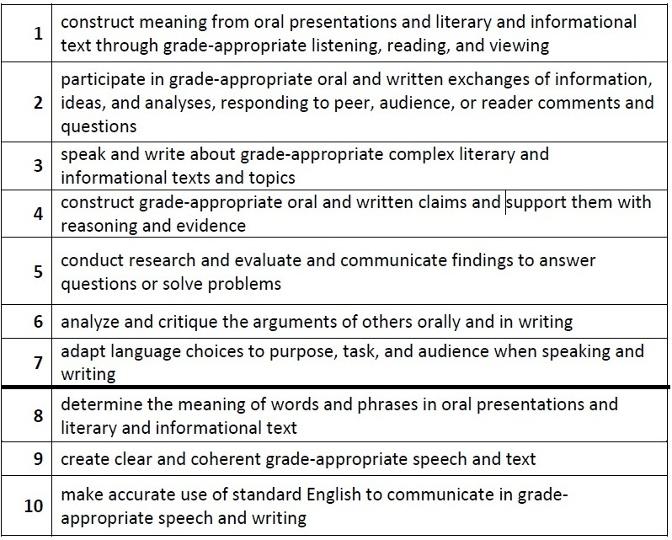
ELP Standards

Slide 4
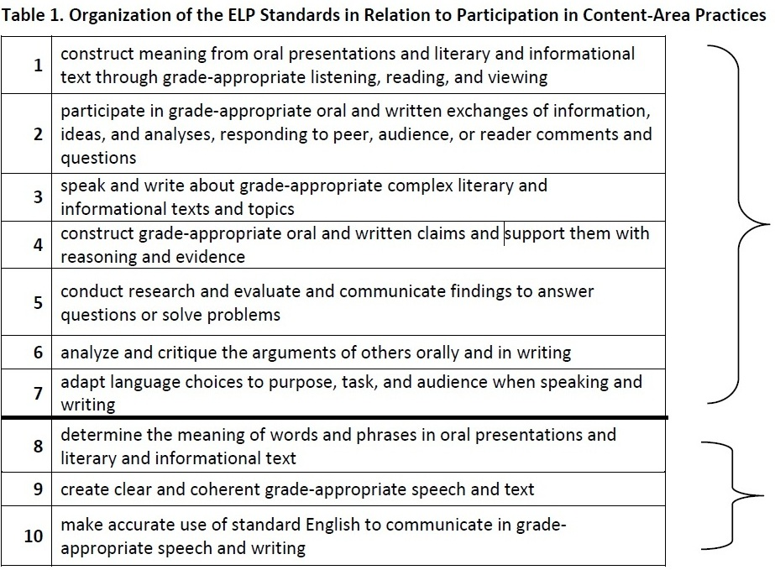
ELP Standards
Notes:
Standards 1 through 7 involve the language necessary for ELLs to engage in the central content-specific practices associated with ELA & Literacy, mathematics, and science. They begin with a focus on extraction of meaning and then progress to engagement in these practices.
Standards 8 through 10 hone in on some of the more micro-level linguistic features that are undoubtedly important to focus on, but only in the service of the other seven standards.
The ELP Standards are interrelated and can be used separately or in combination. (In particular, as shown above, Standards 8–10 support the other seven standards.) The standards do not include curriculum statements, nor do they privilege a single approach to the teaching of social and expressive communication or the teaching of grammar; instead, the standards and descriptors for each proficiency level leave room for teachers, curriculum developers, and states to determine how each ELP Standard and descriptor should be reached and what additional topics should be addressed.

Slide 5
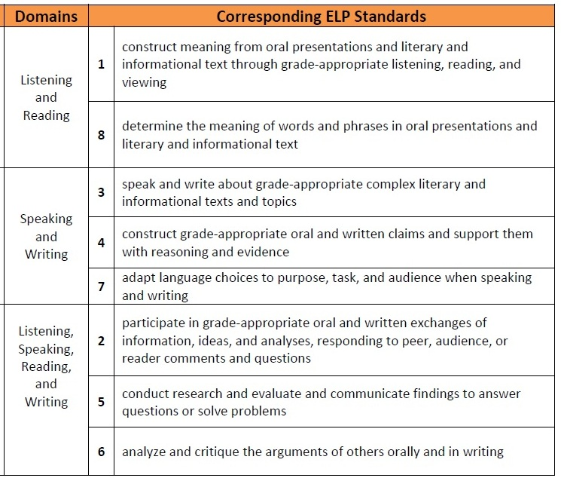
ELP Standards
Modalities
Receptive
Productive
Interactive
Notes:
Receptive modalities: This mode refers to the learner as a reader or listener/viewer working with ‘text’ whose author or deliverer is not present or accessible. It presumes that the interaction is with authentic written or oral documents where language input is meaningful and content laden. The learner brings background knowledge, experience, and appropriate interpretive strategies to the
task to promote understanding of language and content in order to develop a personal reaction.
Productive modalities: The mode places the learner as speaker and writer for a ‘distant’ audience, one with whom interaction is not possible or limited. The communication is set for a specified audience, has purpose, and generally abides by rules of genre or style. It is a planned or formalized speech act or written document, and the learner has an opportunity to draft, get feedback, and revise, before publication or broadcast.
Interactive modalities: Collaborative use of receptive and productive modalities. This mode refers to the learner as a speaker/listener [and] reader/writer. It requires two-way interactive communication where negotiation of meaning may be observed. The exchange will provide evidence of awareness of the socio-cultural aspects of communication as language proficiency develops.

Slide 6
Language Functions
refer
to things and information
create
songs, poems, stories, jokes
narrate
persuade
inform
describe
ask for information
ask for clarification
ask for agreement
express emotions and opinions
interpret
evaluate
summarize
generalize
interact socially
request
offer
paraphrase
introduce
predict
hypothesize
summon
greet
conclude
thank
forgive
apologize
congratulate
direct
advise
warn
threaten
refuse
complain
compliment
metalingual
to discuss and describe language

Slide 7
Which Functions do we need to teach?
refer
to things and information
create
songs, poems, stories, jokes
narrate
persuade
inform
describe
ask for information
ask for clarification
ask for agreement
express emotions and opinions
interpret
evaluate
summarize
generalize
interact socially
request
offer
paraphrase
introduce
predict
hypothesize
summon
greet
conclude
thank
forgive
apologize
congratulate
direct
advise
warn
threaten
refuse
complain
compliment
metalingual
to discuss and describe language

Slide 8
Practices
Math
Science
Make sense of problems and solve them
Plan and carry out investigations
Use math and computational thinking
Reason abstractly and quantitatively
Analyze and interpret data
Construct arguments from evidence
Explain mathmatical concepts and processes
Produce clear and coherent writing
Integrate, compare, and synthesize ideas from text
Build on the ideas of others and articulate one’s own ideas
ELA

Slide 9
Language Functions in the ELP Standards
There is not an official list of 23 functions as in the previous ODE requirements. The new ELP standards use the following words more freely:
Receptive Interactive Productive
Identify,
Determine
Gather,
Label,
Record,
and Sort information
Participate
Follow rules
Answer
Ask questions
Contribute
Build
Respond
Express
Explain
Introduce & Conclude
Compose written narratives & informational texts
Deliver
Retell/recount
Adapt language choices
Expand and rearrange sentences
Link text using temporal and cohesive words

Slide 10
Language Functions and Forms
How might we describe the function of this passage?
Like most individuals with savant syndrome, I am also on the autistic spectrum. I have Asperger’s syndrome, a relatively mild and high-functioning form of autism that affects around 1 in every 300 people in the United Kingdom. According to a 2001 study by the U.K.’s National Autistic Society, nearly half of all adults with Asperger’s syndrome are not diagnosed until after the age of sixteen. I was finally diagnosed at age twenty-five following tests and an interview at the Autism Research Centre in Cambridge.
Autism, including Asperger’s syndrome, is defined by the presence of impairments affecting social interaction, communication, and imagination (problems with abstract or flexible thought and empathy, for example). Diagnosis is not easy and cannot be made by a blood test or brain scan: doctors have to observe behavior and study the individual's developmental history from infancy. from a state-adopted grade 9 text

Slide 11
Language Functions and Forms
What are the formal properties of this passage?
Like most individuals with savant syndrome, I am also on the autistic spectrum. I have Asperger’s syndrome, a relatively mild and high-functioning form of autism that affects around 1 in every 300 people in the United Kingdom. According to a 2001 study by the U.K.’s National Autistic Society, nearly half of all adults with Asperger’s syndrome are not diagnosed until after the age of sixteen. I was finally diagnosed at age twenty-five following tests and an interview at the Autism Research Centre in Cambridge.
Autism, including Asperger’s syndrome, is defined by the presence of impairments affecting social interaction, communication, and imagination (problems with abstract or flexible thought and empathy, for example). Diagnosis is not easy and cannot be made by a blood test or brain scan: doctors have to observe behavior and study the individual's developmental history from infancy. from a state-adopted grade 9 text

Slide 12
Everyday speech vs. written language in school
Everyday speech
Vocabulary
most common verbs, nouns, adjectives, adverbs
Information Density
Short clauses
Simple or compound sent.
Verb-heavy
Few noun modifiers
Few verbal modifiers
Formal writing
Vocabulary
content words specific to the topic
Information Density
Longer clauses
Complex sentences
Noun-heavy
Many noun modifiers
Many verbal modifiers

Slide 15
Everyday speech vs. written language in school
Everyday speech
Vocabulary
most common verbs, nouns, adjectives, adverbs
Information Density
Short clauses
Simple or compound sent.
Verb-heavy
Few noun modifiers
Few verbal modifiers
Formal writing
Vocabulary
content words specific to the topic
Information Density
Longer clauses
Complex sentences
Noun-heavy
Many noun modifiers
Many verbal modifiers

Slide 16
Language Functions and Forms
Vocabulary of formal/academic writing
Like most individuals with savant syndrome, I am also on the autistic spectrum. I have Asperger’s syndrome, a relatively mild and high-functioning form of autism that affects around 1 in every 300 people in the United Kingdom. According to a 2001 study by the U.K.’s National Autistic Society, nearly half of all adults with Asperger’s syndrome are not diagnosed until after the age of sixteen. I was finally diagnosed at age twenty-five following tests and an interview at the Autism Research Centre in Cambridge.
Autism, including Asperger’s syndrome, is defined by the presence of impairments affecting social interaction, communication, and imagination (problems with abstract or flexible thought and empathy, for example). Diagnosis is not easy and cannot be made by a blood test or brain scan: doctors have to observe behavior and study the individual's developmental history from infancy. from a state-adopted grade 9 text

Slide 17
Language Functions and Forms
Vocabulary of formal/academic writing
Like most individuals with savant syndrome, I am also on the autistic spectrum. I have Asperger’s syndrome, a relatively mild and high-functioning form of autism that affects around 1 in every 300 people in the United Kingdom. According to a 2001 study by the U.K.’s National Autistic Society, nearly half of all adults with Asperger’s syndrome are not diagnosed until after the age of sixteen. I was finally diagnosed at age twenty-five following tests and an interview at the Autism Research Centre in Cambridge.
Autism, including Asperger’s syndrome, is defined by the presence of impairments affecting social interaction, communication, and imagination (problems with abstract or flexible thought and empathy, for example). Diagnosis is not easy and cannot be made by a blood test or brain scan: doctors have to observe behavior and study the individual's developmental history from infancy. from a state-adopted grade 9 text

Slide 18
Language Functions and Forms
Noun modification in formal/academic writing
Noun Modifiers
Words and phrases that …
are added either before or after a noun, noun phrase or pronoun to specify its meaning
cannot be moved in the sentence, but can often be deleted without changing the grammar
come in a variety of forms:
Premodifers noun Postmodifiers
adjective prepositional phrase
noun relative clause
-ing/-ed verb non-finite verb clause
appositive noun phrase

Slide 19
Language Functions and Forms
Noun modification in formal/academic writing
Like most individuals with savant syndrome, I am also on the autistic spectrum. I have Asperger’s syndrome, a relatively mild and high-functioning form of autism that affects around 1 in every 300 people in the United Kingdom. According to a 2001 study by the U.K.’s National Autistic Society, nearly half of all adults with Asperger’s syndrome are not diagnosed until after the age of sixteen. I was finally diagnosed at age twenty-five following tests and an interview at the Autism Research Centre in Cambridge.
Autism, including Asperger’s syndrome, is defined by the presence of impairments affecting social interaction, communication, and imagination (problems with abstract or flexible thought and empathy, for example). Diagnosis is not easy and cannot be made by a blood test or brain scan: doctors have to observe behavior and study the individual's developmental history from infancy. from a state-adopted grade 9 text

Slide 20
Language Functions and Forms
Noun modification in formal/academic writing
Like most individuals with savant syndrome, I am also on the autistic spectrum. I have Asperger’s syndrome, a form of autism.
Noun phrase as post-modifier (appositive noun phrase)
Michael Brown, an unarmed 18-year-old, was fatally shot by a police officer.
Oxytocin, a hormone, acts in the brain as a neuromodulator, a neuron that regulates a diverse population of other neurons.

Slide 21
Language Functions and Forms
Noun modification in formal/academic writing
Like most individuals with savant syndrome, I am also on the autistic spectrum. I have Asperger’s syndrome, a relatively mild and high-functioning form of autism that affects around 1 in every 300 people in the United Kingdom.

Slide 22
Language Functions and Forms
Noun modification in formal/academic writing
Like most individuals with savant syndrome, I am also on the autistic spectrum. I have Asperger’s syndrome, a relatively mild and high-functioning form of autism that affects around 1 in every 300 people in the United Kingdom. According to a 2001 study by the U.K.’s National Autistic Society, nearly half of all adults with Asperger’s syndrome are not diagnosed until after the age of sixteen. I was finally diagnosed at age twenty-five following tests and an interview at the Autism Research Centre in Cambridge.

Slide 23
Language Functions and Forms
Noun modification in formal/academic writing
Like most individuals with savant syndrome, I am also on the autistic spectrum. I have Asperger’s syndrome, a relatively mild and high-functioning form of autism that affects around 1 in every 300 people in the United Kingdom. According to a 2001 study by the U.K.’s National Autistic Society, nearly half of all adults with Asperger’s syndrome are not diagnosed until after the age of sixteen. I was finally diagnosed at age twenty-five following tests and an interview at the Autism Research Centre in Cambridge.
Autism, including Asperger’s syndrome, is defined by the presence of impairments affecting social interaction, communication, and imagination (problems with abstract or flexible thought and empathy, for example). Diagnosis is not easy and cannot be made by a blood test or brain scan: doctors have to observe behavior and study the individual's developmental history from infancy. from a state-adopted grade 9 text

Slide 24
Language Functions and Forms
Adverbial modification in formal/academic writing
Adverbial Modifiers
Words and phrases that …
are added as modifiers to the core subject and predicate of a clause
provide information about when, where, why, how, how much, how many, and to what degree
can often be moved around in the clause
come in a variety of forms:
single word adverbs,
prepositional phrases,
adverbial clauses,
non-finite verb clauses/phrases

Slide 25
Language Functions and Forms
Adverbial modification in formal/academic writing
Like most individuals with savant syndrome, I am also on the autistic spectrum. I have Asperger’s syndrome, a relatively mild and high-functioning form of autism that affects around 1 in every 300 people in the United Kingdom. According to a 2001 study by the U.K.’s National Autistic Society, nearly half of all adults with Asperger’s syndrome are not diagnosed until after the age of sixteen. I was finally diagnosed at age twenty-five following tests and an interview at the Autism Research Centre in Cambridge.
Autism, including Asperger’s syndrome, is defined by the presence of impairments affecting social interaction, communication, and imagination (problems with abstract or flexible thought and empathy, for example). Diagnosis is not easy and cannot be made by a blood test or brain scan: doctors have to observe behavior and study the individual's developmental history from infancy. from a state-adopted grade 9 text

Slide 26
Language Functions and Forms
Adverbial modification in formal/academic writing
Like most individuals with savant syndrome, I am also on the autistic spectrum. I have Asperger’s syndrome, a relatively mild and high-functioning form of autism that affects around 1 in every 300 people in the United Kingdom. According to a 2001 study by the U.K.’s National Autistic Society, nearly half of all adults with Asperger’s syndrome are not diagnosed until after the age of sixteen. I was finally diagnosed at age twenty-five following tests and an interview at the Autism Research Centre in Cambridge.
Autism, including Asperger’s syndrome, is defined by the presence of impairments affecting social interaction, communication, and imagination (problems with abstract or flexible thought and empathy, for example). Diagnosis is not easy and cannot be made by a blood test or brain scan: doctors have to observe behavior and study the individual's developmental history from infancy. from a state-adopted grade 9 text

Slide 27
Language Functions and Forms
Research and Attribution of source information
Like most individuals with savant syndrome, I am also on the autistic spectrum. I have Asperger’s syndrome, a relatively mild and high-functioning form of autism that affects around 1 in every 300 people in the United Kingdom. According to a 2001 study by the U.K.’s National Autistic Society, nearly half of all adults with Asperger’s syndrome are not diagnosed until after the age of sixteen. I was finally diagnosed at age twenty-five following tests and an interview at the Autism Research Centre in Cambridge.
Autism, including Asperger’s syndrome, is defined by the presence of impairments affecting social interaction, communication, and imagination (problems with abstract or flexible thought and empathy, for example). Diagnosis is not easy and cannot be made by a blood test or brain scan: doctors have to observe behavior and study the individual's developmental history from infancy. from a state-adopted grade 9 text

Slide 28
Language Functions and Forms
Like most individuals with savant syndrome, I am also on the autistic spectrum. I have Asperger’s syndrome, a relatively mild and high-functioning form of autism that affects around 1 in every 300 people in the United Kingdom. According to a 2001 study by the U.K.’s National Autistic Society, nearly half of all adults with Asperger’s syndrome are not diagnosed until after the age of sixteen. I was finally diagnosed at age twenty-five following tests and an interview at the Autism Research Centre in Cambridge.
Autism, including Asperger’s syndrome, is defined by the presence of impairments affecting social interaction, communication, and imagination (problems with abstract or flexible thought and empathy, for example). Diagnosis is not easy and cannot be made by a blood test or brain scan: doctors have to observe behavior and study the individual's developmental history from infancy. from a state-adopted grade 9 text

Slide 29
The Goal of Contextualized ELD
that FUNCTION MEANINGfully
for USE in academic PRACTICES
To teach language FORMS

Slide 30
Lunch

Slide 31
Project High Five: Survey and release form
Please refer to “Project high Five: Culturally Responsive Teaching Survey” and “WOU Model Release” form in binder.
Complete the survey and release form and turn in to us.
All information and all of your responses on the survey and your names on the release form will be kept strictly confidential.
Notes:
8:50-9:05 CHLOE
Refer participants to white “Project High Five: Culturally Responsive Teaching Survey” and white “WOU Model Release” form in their binder.
Because we have a grant designed to explore whether co-teaching, contextualized ELD, and community based service learning makes a difference to student outcomes, teacher practice and teacher candidate’s success, we need to gather and analyze data—written and recorded.
15 minutes to complete survey and release forms.
Sue to collect everyone’s forms

Slide 32
Project High Five: Graduate Credit
Do you want to take the class for credit?
2 graduate credits
Cost would usually be $50 per credit, but the grant will pay this for you!
Ask us for a syllabus and course registration form.
Notes:
8:45 SUSAN
Susan Griffin to discuss requirements and provide registration form

Slide 34
Example of Collaborative Contextual ELD
ELA
ELD
ELLs participate
All students participate
ELP standards guide instruction
CCSS for ELA guide instruction
Content from ELA class is the vehicle for language instruction
ELD functions and forms are reinforced and practiced

Slide 35
Example of Collaborative Contextual ELD
To Kill A Mockingbird unit English Language Arts class
Traditional approach to Point of View (literary perspective)
Who is the narrator?
What narrative perspective is the story told from?
How is our understanding of the story influenced by Lee’s choice to tell the story through Scout’s (adult) eyes?
How would the story be different if told in 3rd person PoV?
CCSS: Standard 6: “Assess how point of view or purpose shapes the content and style of a text.”

Slide 36
Example of Collaborative Contextual ELD
To Kill A Mockingbird unit English Language Arts class
Incorporating Critical Literacy with Point of View
Since critical literacy asks readers to look at what lies in a text as well as what is not there, point of view can be taught asking these questions:
Whose point of view is absent in this text?
How does the choice of narrator privilege some and disempower others?
Understanding that the sociopolitical context outside the novel informed Lee’s choice of point of view, how can we engage students in similar contemporary issues?
RL9-10.1 Cite strong and thorough textual evidence to support analysis of what the text says explicitly as well as inferences drawn from the text.

Slide 37
SL9-10.3 Evaluate a speaker’s point of view, reasoning, and use of evidence and rhetoric, identifying any fallacious reasoning or exaggerated or distorted evidence.
W9-10.7 Conduct short as well as more sustained research projects to answer a question or solve a problem; narrow or broaden the inquiry when appropriate; synthesize multiple sources on the subject, demonstrating understanding of the subject.
RL9-10.7 Analyze the representation of a subject or a key scene in two different artistic mediums, including what is emphasized and absent from each treatment.

Slide 38
Example of Collaborative Contextual ELD
To Kill A Mockingbird unit English Language Development class
The Language that creates and influences Point of View
First, Second, and Third person pronouns
Evaluative words that signal opinion
Maycomb was an old town, but it was tired old town when I first knew it. In rainy weather the streets turned to red slop; grass grew on the sidewalks, the courthouse sagged in the square. Somehow, it was hotter then: a black dog suffered on a summer’s day; bony mules hitched to Hoover carts flicked flies in the sweltering shade of the live oaks on the square. … People moved slowly then. They ambled across the square, shuffled in and out of the stores around it, took their time about everything.

Slide 39
Example of Collaborative Contextual ELD
To Kill A Mockingbird unit English Language Development class
The Language that creates and influences Point of View
First, Second, and Third person pronouns
Evaluative words that signal opinion (adjectives, verbs, nouns, adverbs)
Maycomb was an old town, but it was tired old town when I first knew it. In rainy weather the streets turned to red slop; grass grew on the sidewalks, the courthouse sagged in the square. Somehow, it was hotter then: a black dog suffered on a summer’s day; bony mules hitched to Hoover carts flicked flies in the sweltering shade of the live oaks on the square. … People moved slowly then. They ambled across the square, shuffled in and out of the stores around it, took their time about everything.

Slide 40
Example of Collaborative Contextual ELD
To Kill A Mockingbird unit English Language Development class
The Language that creates and influences Point of View
Signals of narrator’s temporal location
Signals of narrator’s physical location

Slide 41
Example of Collaborative Contextual ELD
To Kill A Mockingbird unit English Language Development class
The Language that creates and influences Point of View
Signals of narrator’s temporal location
Signals of narrator’s physical location
Maycomb was an old town, but it was tired old town when I first knew it. In rainy weather the streets turned to red slop; grass grew on the sidewalks, the courthouse sagged in the square. Somehow, it was hotter then: a black dog suffered on a summer’s day; bony mules hitched to Hoover carts flicked flies in the sweltering shade of the live oaks on the square. … People moved slowly then. They ambled across the square, shuffled in and out of the stores around it, took their time about everything.

Slide 42
Example of Collaborative Contextual ELD
To Kill A Mockingbird unit English Language Development class
The Language that creates and influences Point of View
Signals of narrator’s temporal location
Signals of narrator’s physical location
Maycomb was an old town, but it was tired old town when I first knew it. In rainy weather the streets turned to red slop; grass grew on the sidewalks, the courthouse sagged in the square. Somehow, it was hotter then: a black dog suffered on a summer’s day; bony mules hitched to Hoover carts flicked flies in the sweltering shade of the live oaks on the square. … People moved slowly then. They ambled across the square, shuffled in and out of the stores around it, took their time about everything.

Slide 43
Steps in Lesson Plan Creation
1. Considering the unit, materials, and needs of your students,
what ELA or ELP standards will you meet?
what function(s) will you teach (what will students DO with language)?
2. Considering the level of your students—determine which forms they will need to be taught in order to accomplish the work.
3. Add each function and form to your personal curriculum map for tracking.
4. Examine your materials to see if the forms are present in them or if you will need to teach them directly.
5. Fill out Function/Form Analysis Chart
6. What tasks will the students do? (30 min)
(Receptive, Interactive, Productive)
Teacher modeling
Group or scaffolded practice
Individual practice
7. How will I assess students’ learning?

Slide 45
Looking Forward
Tomorrow
Bring any teaching materials for this fall in which you want to include some explicit language teaching
Please read the Fillmore and Fillmore article downloadable from our website:
http://woucentral.weebly.com/

Slide 46
Project High-5
Culture, Collaboration, Commitment, Communication, & Community
Exit Ticket
Before you leave, please complete the following statement:
In planning for my lessons this year,
I’ll keep in mind the following principles of effective instruction for ELLs:

