Slide 1



Project LUISA
Language Understanding to Improve Student Achievement
Session 2. Tuesday, Aug 20, 2013, 8:00 – 4:00
1. Sharing Monday Afternoon’s Accomplishments
2. Review Analyzing Functions and Forms and Lesson Creation
3. Discussion of Fillmore & Fillmore Article
Break
4. Text Complexity
5. Form & Meaning: Prepositional Phrases
Lunch
6. Work Time
7. Looking Forward

Slide 2


Sharing accomplishments
from Monday afternoon

Slide 4
Yesterday we read…
A neighborhood is where you live, learn, grow up, play, and work. In your neighborhood you are surrounded by your family and friends. Each and every neighborhood is a special place. Yours might be in the mountains, along a coast, or somewhere in between. It may be part of a village, town, or big city. Neighborhoods around the world can look very different. Some neighborhoods have lots and lots of people in them, while others have only a small population. A neighborhood on a small island or high up on a mountain might only have a few people in it. Some neighborhoods are made up of a few buildings in a town or village, while others stretch for miles and miles and are part of a big city.

Slide 5
Yesterday we read…
A neighborhood is where you live, learn, grow up, play, and work. In your neighborhood you are surrounded by your family and friends. Each and every neighborhood is a special place. Yours might be in the mountains, along a coast, or somewhere in between. It may be part of a village, town, or big city. Neighborhoods around the world can look very different. Some neighborhoods have lots and lots of people in them, while others have only a small population. A neighborhood on a small island or high up on a mountain might only have a few people in it. Some neighborhoods are made up of a few buildings in a town or village, while others stretch for miles and miles and are part of a big city.

Slide 6
Analysis of Language Functions and Forms
Compare and Contrast
Grade Theme of the Language level: literacy unit: Function:
Examples of target Form from teaching materials or from a sample of student writing that can be given to a language learner.
Beginning Form: Conjunctions: and, both Examples: A small neighborhood and a big neighborhood both have families and friends. Example Sentence Frame: A _______ and a _______ both have ____________. are | Intermediate Form: | Advanced Form:
1st-2nd
Neighborhoods

Slide 7
Yesterday we read…
A neighborhood is where you live, learn, grow up, play, and work. In your neighborhood you are surrounded by your family and friends. Each and every neighborhood is a special place. Yours might be in the mountains, along a coast, or somewhere in between. It may be part of a village, town, or big city. Neighborhoods around the world can look very different. Some neighborhoods have lots and lots of people in them, while others have only a small population. A neighborhood on a small island or high up on a mountain might only have a few people in it. Some neighborhoods are made up of a few buildings in a town or village, while others stretch for miles and miles and are part of a big city.
The text my students read doesn’t contain the Form,
so I need to teach the form and induce students to use it.

Slide 8
Create ELL materials and/or tasks
Theme: Neighborhoods
Function: Comparison and Contrast
Beginning Form: Conjunctions: and, both
While other students are working on their tasks, my 2 beginning level ELLs will work together to fill out a comparison and contrast chart based on the reading.
Small neighborhoods | All neighborhoods | Big neighborhoods

Slide 9
Create ELL materials and/or tasks
Student A
Small neighborhoods and big neighborhoods both have families in them.
Small neighborhoods have few people but big neighborhoods have many people.
Small neighborhoods 1. Few people 2. ________________ 3. A few buildings | All neighborhoods 1. Families 2. _________________ 3. _________________ | Big neighborhoods 1. Many people 2. __________________ 3. Miles of streets
Ask your partner:
What do small neighborhoods and big neighborhoods both have?
What do small neighborhoods have but big neighborhoods do not?
Student B
Small neighborhoods and big neighborhoods both have friends in them.
Small neighborhoods have few houses and apartments but big neighborhoods have many.
Small neighborhoods 1. __________________ 2. Few houses and apartments 3. __________________ | All neighborhoods 1. ________________ 2. Friends 3. Something special | Big neighborhoods 1. ___________________ 2. Many houses and apartments 3. ___________________
Ask your partner:
What do small neighborhoods and big neighborhoods both have?
What do small neighborhoods have but big neighborhoods do not have?

Slide 10
Create ELL materials and/or tasks
Theme: Neighborhoods
Function: Comparison and Contrast
Beginning Form: Conjunctions: and, both
While other students are working on their tasks, my 2 beginning level ELLs will work together to fill out a comparison and contrast chart based on the reading.
Small neighborhoods | All neighborhoods | Big neighborhoods
After they work together to fill out the chart, they should write in their journals:
“How is your house similar to and different from school?”
Use the words and, both, and but at least one time each.

Slide 11
Analysis of Language Functions and Forms
Compare and Contrast
Grade Theme of the Language level: literacy unit: Function:
Examples of target Form from teaching materials or from a sample of student writing that can be given to a language learner.
Beginning Form: Conjunctions: and, both Examples: A small neighborhood and a big neighborhood both have families and friends. Example Sentence Frame: A _______ and a _______ both have ____________. are | Intermediate Form: Conjunctions: both, but, while, however Examples: Some neighborhoods have lots and lots of people in them, while others have only a small population. Example Sentence Frame: A _____ has/is ________ while a ________ has/is __________. | Advanced Form:
1st-2nd
Neighborhoods

Slide 12
Yesterday we read…
A neighborhood is where you live, learn, grow up, play, and work. In your neighborhood you are surrounded by your family and friends. Each and every neighborhood is a special place. Yours might be in the mountains, along a coast, or somewhere in between. It may be part of a village, town, or big city. Neighborhoods around the world can look very different. Some neighborhoods have lots and lots of people in them, while others have only a small population. A neighborhood on a small island or high up on a mountain might only have a few people in it. Some neighborhoods are made up of a few buildings in a town or village, while others stretch for miles and miles and are part of a big city.
The text my students read contains one Form,
but our discussion and their writing can include more.

Slide 13
Create ELL materials and/or tasks
Theme: Neighborhoods
Function: Comparison and Contrast
Intermediate Form: Conjunctions: both, but, while, however
While other students are working on their tasks, my 3 intermediate level ELLs will work together to fill out a contrast chart based on the reading.
Small neighborhoods |  | Big neighborhoods

Slide 14
Create ELL materials and/or tasks
Student A
Small neighborhoods have a small population; however big ones have a large population. Small neighborhoods have a few buildings while big ones have miles of streets.
Small neighborhoods 1. Small population 2. ________________ 3. A few buildings 4. ________________ |  | Big neighborhoods 1. Large population 2. __________________ 3. Miles of streets 4.___________________
Ask your partner: How are small neighborhoods different from big ones?
Student B
Small neighborhoods have few houses and apartments; however big ones have many. Small neighborhoods are part of villages or towns while big ones are part of large cities.
Small neighborhoods 1. __________________ 2. Few houses and apartments 3. __________________ 4. Part of villages or towns |  | Big neighborhoods 1. ___________________ 2. Many houses and apartments 3. ___________________ 4. Part of large cities
Ask your partner: How are small neighborhoods different from big ones?

Slide 15
Create ELL materials and/or tasks
Theme: Neighborhoods
Function: Comparison and Contrast
Intermediate Form: Conjunctions: both, but, while, however
While other students are working on their tasks, my 3 intermediate level ELLs will work together to fill out a contrast chart based on the reading.
Small neighborhoods |  | Big neighborhoods
In your journal, write about the topic:
“How is your house similar to and different from school?”
Use the words both, but, while, and however at least one time each. Start with the sentence:
“Both my house and my school are nice places, but I …”

Slide 16
Analysis of Language Functions and Forms
Compare and Contrast
Grade Theme of the Language level: literacy unit: Function:
Examples of target Form from teaching materials or from a sample of student writing that can be given to a language learner.
Beginning Form: Conjunctions: and, both Examples: A small neighborhood and a big neighborhood both have families and friends. Example Sentence Frame: A _______ and a _______ both have ____________. are | Intermediate Form: Conjunctions: both, but, while, however Examples: Some neighborhoods have lots and lots of people in them, while others have only a small population. Example Sentence Frame: A _____ has/is ________ while a ________ has/is __________. | Advanced Form: Conjunctions: not only, although Examples: Although some neighborhoods are small, they all have family and friends. Example Sentence Frame: Although some ________ are ____________, they all have/are _____________.
1st-2nd
Neighborhoods

Slide 17
Yesterday we read…
A neighborhood is where you live, learn, grow up, play, and work. In your neighborhood you are surrounded by your family and friends. Each and every neighborhood is a special place. Yours might be in the mountains, along a coast, or somewhere in between. It may be part of a village, town, or big city. Neighborhoods around the world can look very different. Some neighborhoods have lots and lots of people in them, while others have only a small population. A neighborhood on a small island or high up on a mountain might only have a few people in it. Some neighborhoods are made up of a few buildings in a town or village, while others stretch for miles and miles and are part of a big city.
The text my students read doesn’t contain the Form,
so I need to teach the form and induce students to use it.

Slide 18
Create ELL materials and/or tasks
Theme: Neighborhoods
Function: Comparison and Contrast
Advanced Form: Conjunctions: not only, although
While other students are working on their tasks, my 3 advanced level ELLs will work together to fill out a comparison and contrast chart based on the reading.
Small neighborhoods | All neighborhoods | Big neighborhoods

Slide 19
Create ELL materials and/or tasks
Student A
Although small neighborhoods have few people, they all have families in them.
Although small neighborhoods have few buildings, they all have something special.
Small neighborhoods 1. Few people 2. Few houses and apartments 3. A few buildings | All neighborhoods 1. Families 2. Friends 3. Something special | Big neighborhoods 1. __________________ 2. __________________ 3. __________________
Ask your partner:
How are big neighborhoods different from all neighborhoods?
Student B
Although all neighborhoods have families, only big neighborhoods have many people.
Although all neighborhoods have friends, only big neighborhoods have many houses.
Small neighborhoods 1. __________________ 2. __________________ 3. __________________ | All neighborhoods 1. Families 2. Friends 3. Something special | Big neighborhoods 1. Many people 2. Many houses and apartments 3. Miles of streets
Ask your partner:
How are small neighborhoods different from all neighborhoods?

Slide 20
Create ELL materials and/or tasks
Theme: Neighborhoods
Function: Comparison and Contrast
Advanced Form: Conjunctions: not only, although
While other students are working on their tasks, my 3 advanced level ELLs will work together to fill out a comparison and contrast chart based on the reading.
Small neighborhoods | All neighborhoods | Big neighborhoods
In your journal, write about the topic:
“How is your house similar to and different from school?”
Use the words although and not only at least one time each.
Start with: “My house is not only ________ but also ______.

Slide 22
What Does Text Complexity Mean
for English Learners and Language Minority Students?
(Fillmore and Fillmore, 2012)

Slide 23
What Does Text Complexity Mean
for English Learners and Language Minority Students?
(Fillmore and Fillmore, 2012)
The language used in complex texts is difficult and cannot be learned through talking with native speakers, but only though working with the texts themselves.
It is especially critical that students have access to complex texts because after fourth grade, they serve as the vehicle for content delivery. (K-3: Learning to read; 4-12: Reading to learn)
Academic texts are marked by INFORMATIONAL DENSITY: every clause or phrase contains information critical to understanding the topic.

Slide 24
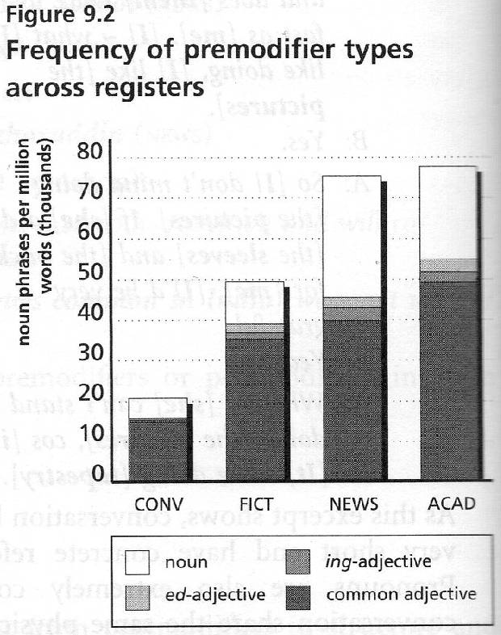
(Biber, Conrad, and Leech, 2002)

Slide 25
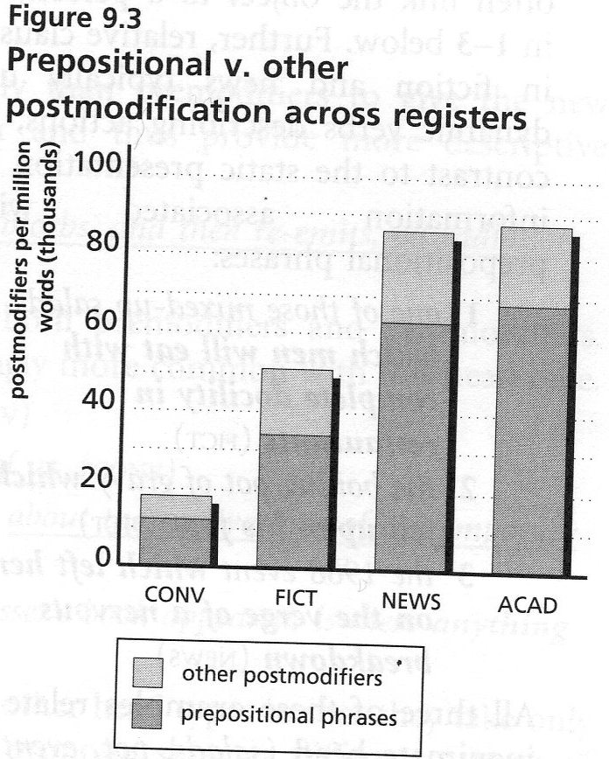
(Biber, Conrad, and Leech, 2002)

Slide 26
Strategy: Looking Closely at Language
One Sentence at a Time
Students do not necessarily need to learn the grammatical and linguistic terms related to complex texts, but they do need to learn how to understand the ideas found in such writing.
Planning is necessary: teachers must choose a sentence that is grammatically interesting and complex, and which contains ideas necessary for understanding the content.
The practice helps teachers engage their students in the “consciousness-raising” and “noticing” of language forms referred to by Larsen-Freeman (2001).
In the example cited by the authors, teachers engaged in the practice just 15-20 minutes daily.

Slide 27
One Sentence Analysis
The Secret Garden by Frances Hodgson Burnett
It was in that strange and sudden way that Mary found out that she had neither father nor mother left; that they had died and been carried away in the night, and that the few native servants who had not died also had left the house as quickly as they could get out of it, none of them even remembering that there was a Missie Sahib (p. 7).

Slide 28
One Sentence Analysis
The Secret Garden by Frances Hodgson Burnett
It was in that strange and sudden way that Mary found out that she had neither father nor mother left;
Mary found out that she had neither father nor mother left;
[in that strange and sudden way]

Slide 29
One Sentence Analysis
The Secret Garden by Frances Hodgson Burnett
Mary found out
that she had neither mother nor father left
that they had died and been carried away in the night
that the few native servants
who had not died
as quickly as they could get out of it
none of them remembering
that there was a Missie Sahib.
[WHAT DID SHE FIND OUT?]
[WHAT HAPPENED TO THEM?]
[AND?]
[WHICH ONES?]
also had left the house
[HOW DID THEY LEAVE THE HOUSE?]
[ANYTHING ELSE?]
[REMEMBERING WHAT?]

Slide 30
One Sentence Analysis
Eruption!
The rock that comes out of a volcano is called lava (8).
The rock [that comes out of a volcano] is called lava.

Slide 32
Form and Meaning: Prepositional Phrases
The Most Frequent Prepositions?
A preposition + a noun phrase
While some of its articles are technical, requiring
an understanding of voice spectrograms, others are
accessible to anyone.

Slide 33
Form and Meaning: Prepositional Phrases
A preposition + a noun phrase
While some of its articles are technical, requiring
an understanding of voice spectrograms, others are
accessible to anyone.
1) post-noun modifier 2) sentence modifier

Slide 34
Prepositional Phrases in non-fiction
Horses were unknown in North America until the 1500s, when Spanish explorers began arriving. The explorers sailed from Spain with horses onboard their ships. They used the horses to explore the New World. During this exploration many of the horses were lost.
5th Grade History text

Slide 35
Prepositional Phrases in non-fiction
Horses were unknown in North America until the 1500s, when Spanish explorers began arriving. The explorers sailed from Spain with horses onboard their ships. They used the horses to explore the New World. During this exploration many of the horses were lost.
5th Grade History text

Slide 36
Frequency of Prepositions
in Conversational vs. Academic English
Biber, Conrad, & Leech. 2002. Longman Grammar of Spoken and Written English.
# of Prepositions
per 1000 words

Slide 37
Prepositional Phrases
the 4 functions
prepositional phrases that tell
when, where, why, how,
how much, how long
prepositional phrases
that modify nouns
The teachers will finish at 2:30.
Many of the students are studying.
prepositional phrases
that link ideas
In addition, we will provide snacks.
prepositional phrases
that express attitude, point of view
To my surprise, it was a lot of fun.

Slide 38
Prepositional Phrases
the 4 functions
prepositional phrases that tell
when, where, why, how,
how much, how long
prepositional phrases
that modify nouns
We left
at midnight.
prepositional phrases
that link ideas
These kinds of questions are easy.
Take, for example, a rubber chicken.
In my opinion, that’s a great idea.
prepositional phrases
that express attitude, point of view

Slide 39
Prepositional Phrases
the 4 functions
Let’s see
where
the leaves
grow!
prepositional phrases that tell
when, where, why, how,
how much, how long
prepositional phrases
that modify nouns
prepositional phrases
that link ideas
prepositional phrases
that express attitude, point of view

Slide 40
Taming Syntax
Helping students deal with information overload
English sentences are hierarchically organized, so
-teach students to focus their attention on the head noun of the subject, the main verb, objects, and conjunctions.
-modifiers add extra (less important) information
The Drake stopped at Alexandria, Bengasi, Tripoli, Tunis and Algiers, passed the Rock of Gibraltar and turned north up the coast of Portugal.
The Drake stopped at Alexandria, Bengasi, Tripoli, Tunis and Algiers, passed the Rock of Gibraltar and turned north up the coast of Portugal.

Slide 41
Taming Syntax
Helping students deal with information overload
English sentences are hierarchically organized, so
-teach students to focus their attention on the head noun of the subject, the main verb, objects, and conjunctions.
-modifiers add extra (less important) information
Horses were unknown in North America until the 1500s, when Spanish explorers began arriving.
Horses were unknown in North America until the 1500s, when Spanish explorers began arriving.

Slide 43
Presentation Schedule for Tomorrow
Lunch
1:00-1:15 Kinder: Jose, Michelle
1:15-1:30 1st: Kourtney, Candice, Karrie
1:30-1:45 2nd: Melody, Cheryl
1:45-2:00 3rd: Chelsey , Trixia, Pam
2:00-2:15 4th: Cheryl, Alice
2:15-2:30 5th: Brian, Bailey

Slide 44
Project LUISA
Language Understanding to Improve Student Achievement
Looking Forward
Tomorrow
1. Bring any teaching materials for next fall in which you want to include some explicit language teaching.
2. Bring your Azar Grammar Chartbook.
3. Prepare for presentations for Wed afternoon.

