Slide 1



Project LUISA
Language Understanding to Improve Student Achievement
Session 5. Feb 15, 2013
1. Welcome: infusing language instruction in content
2. Mathematics
3. This week’s reading
4. Social Studies
5. Science
6. Looking Forward

Slide 3


Sentence Frames: Review for Quadrilaterals
1. ____________________ has _______________________.
2. ____________________ has _______________________.
3. ____________________ are _______________________.
4. ____________________ are _______________________.
5. ____________________ are _______________________.
6. ____________________bisect ______________________.
7. ____________________bisect ______________________.

Slide 5
About the reading (Creese, 2010)
Task 1: Say/write/draw something about the article.
Task 2: Draw a Venn diagram where you can capture the similarities and differences mentioned in the text between the geography teacher and the EAL (English as an additional language) teacher

Slide 7
Prepositional Phrases
A preposition + a noun phrase
While some of its articles are technical, requiring
an understanding of voice spectrograms, others are
accessible to anyone.
1) post-noun modifier 2) sentence modifier
The Most Frequent Prepositions
OF IN TO FOR WITH ON
AT FROM BY AS ABOUT INTO
LIKE THROUGH AFTER OVER BETWEEN OUT
DURING AGAINST BEFORE WITHOUT UNDER AMONG
AROUND SUCH TOWARD WITHIN ACROSS OFF
BEHIND ALONG UP PER UPON NEAR
THAN DESPITE BEYOND AWAY ONTO ABOVE
SINCE OUTSIDE INSIDE DOWN FRONT UNTIL

Slide 8
Prepositional Phrases in non-fiction
Horses were unknown in North America until the 1500s, when Spanish explorers began arriving. The explorers sailed from Spain with horses onboard their ships. They used the horses to explore the New World. During this exploration many of the horses were lost.
5th Grade History text

Slide 9
Prepositional Phrases in non-fiction
Horses were unknown in North America until the 1500s, when Spanish explorers began arriving. The explorers sailed from Spain with horses onboard their ships. They used the horses to explore the New World. During this exploration many of the horses were lost.
5th Grade History text

Slide 10
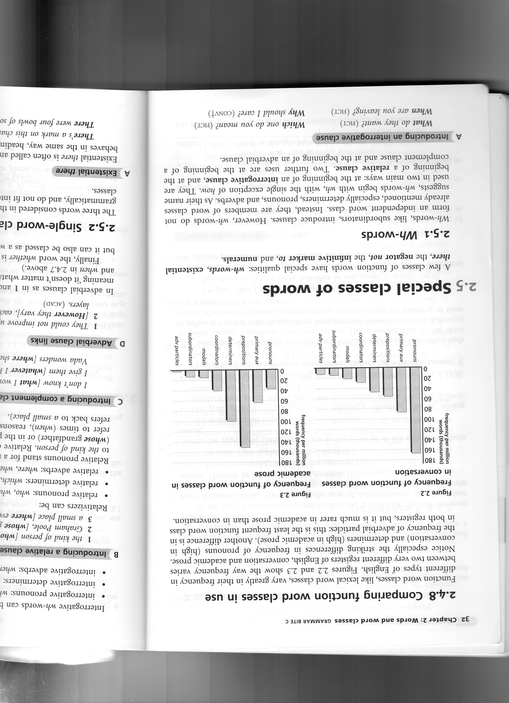
Biber, Conrad, & Leech. 2002. Longman Grammar of Spoken and Written English.

Slide 11
Prepositional Phrases
Tree
prepositional phrases that tell
when, where, why, how,
how much, how long
prepositional phrases
that link ideas
prepositional phrases
that follow nouns
prepositional phrases
that express attitude, certainty, point of view

Slide 12
Prepositional Phrases
Tree
in January, at midnight
from here, to the store, in chapter 2
for an assignment, with good grades
with joy, like an animal, by train
at 375 degrees
for a week
in other words, in addition,
for example, in contrast,
by the way, for one thing,
in conclusion
lots of work, a piece of cake,
these kinds of questions, the front of the…, the shape of the…,
the mess in his bedroom,
your health in the long run,
the search for new ideas
in fact, of course,
from my perspective,
on the whole, to my surprise, according to the author

Slide 13
Prepositional Phrases in English
Teacher Noticing Task 2: proficient use of English
Read your text and then work together to:
  underline all of the prepositional phrases.
  write each one on your prepositional tree
Discuss your findings with your partners.

Slide 15
Syntax—ELL student
I Can Fly
I can Fly. When I was litle my Mom teach to fly. I Fly every where. I look for food. I have friend when I was flying and still looking at food. My mom go looking the nother food. I hate finger nails. I have a big body. I have a good food. I play with my friend. My mom have a new friend and we all play together. we have a party. I'm happy and I have a big head. The next day. I com back to my home. I go to sleep at home. I like being a bird.
sent # | words/ sent | Indep clauses/ sent | Dep clauses/ sent | Prep phrases/ sent | other modif/ sent
1 | 3 | 1 | 0 | 0 | 0
2 | 9 | 1 | 1 | 0 | 0
3 | 4 | 1 | 0 | 0 | 0
4 | 4 | 1 | 0 | 1 | 0
5 | 12 | 1 | 1 | 1 | 0
6 | 7 | 1 | 0 | 0 | 0
7 | 3 | 1 | 0 | 0 | 0
8 | 5 | 1 | 0 | 0 | 0
9 | 5 | 1 | 0 | 0 | 0
10 | 5 | 1 | 0 | 1 | 0
11 | 11 | 2 | 0 | 0 | 0
12 | 4 | 1 | 0 | 0 | 0
13 | 9 | 2 | 0 | 0 | 0
14 | 3 | 0 | 0 | 0 | 0
15 | 6 | 1 | 0 | 1 | 0
16 | 6 | 1 | 0 | 1 | 0
17 | 5 | 1 | 0 | 0 | 0
 | 101 | 18 | 2 | 5 | 0
 | 5.9 | 1.06 | .12 | .29 | 0

Slide 16
Syntax
Helping students deal with information overload
English sentences are hierarchically organized, so
-teach students to focus their attention on the head noun of the subject, the main verb, complement, and conjunctions.
-modifiers add extra (less important) information
The Drake stopped at Alexandria, Bengasi, Tripoli, Tunis and Algiers, passed the Rock of Gibraltar and turned north up the coast of Portugal.
The Drake stopped at Alexandria, Bengasi, Tripoli, Tunis and Algiers, passed the Rock of Gibraltar and turned north up the coast of Portugal.

Slide 17
Syntax
Helping students deal with information overload
English sentences are hierarchically organized, so
-teach students to focus their attention on the head noun of the subject, the main verb, complement, and conjunctions.
-modifiers add extra (less important) information
Horses were unknown in North America until the 1500s, when Spanish explorers began arriving.
Horses were unknown in North America until the 1500s, when Spanish explorers began arriving.

Slide 19
Project LUISA
Language Understanding to Improve Student Achievement
Looking Forward
Wed, Feb 20. Session 6: Authentic Formative Assessment
Read: Lewis (2005)
Bring your materials and work so far.
Bring your Azar grammar chartbook.
Check out our course website as we add resources.

